Slide 1
Soil Erosion
Chad Lentz

Slide 2
Why Care?
Removes valuable topsoil
Carries away expensive nutrients
Increase tillage costs to fix
Creates algae blooms and dead zones due to excess nutrients in waterways

Slide 3
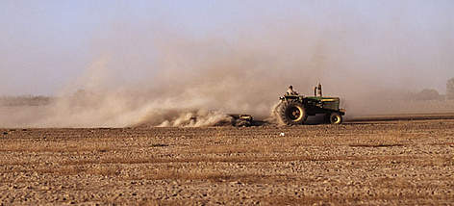
Types of Erosion
Wind:
Problem with dry, bare land with high winds
Not easily seen in some instances
Water:
Problem in steep sloped areas
Causes problems with marine life
Has many forms that vary in severity

Slide 4
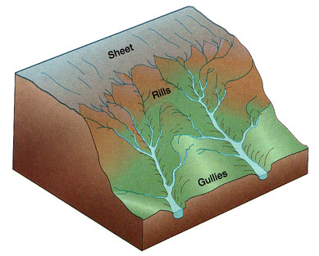
Types of Water Erosion
Sheet Erosion
Rill Erosion
Gully Erosion
Stream bank Erosion

Slide 5
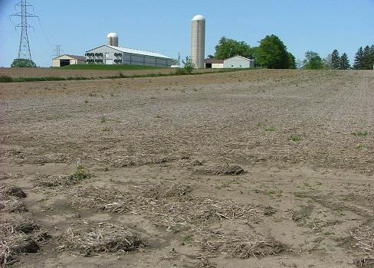
Sheet Erosion
Soil is removed evenly
Only removes a small layer of soil from the area
Quickly turns into rill erosion

Slide 6
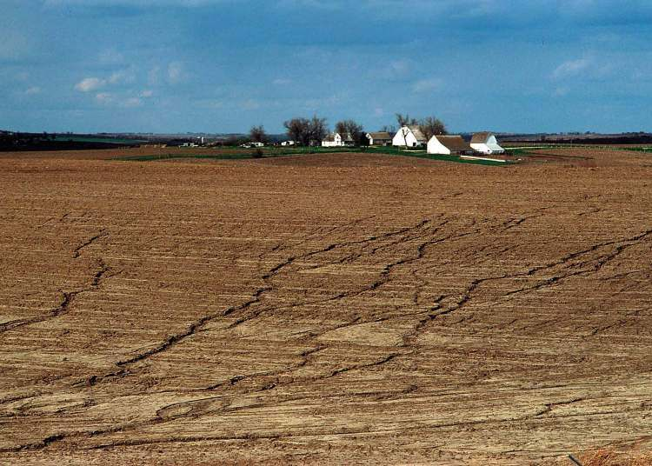
Rill Erosion
Small channels of water can be seen
Soil is beginning to move away at a quicker rate
Can still be fixed with normal tillage practices

Slide 7
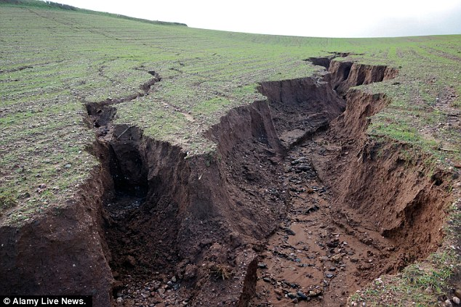
Gully Erosion
Large channels that carry away soil and water
Generally removes less soil than sheet and rill erosion
Can no longer be fixed with tillage practices
If left unchecked can become a major problem

Slide 8
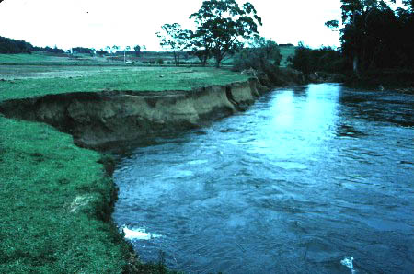
Stream Bank Erosion
Constantly occurring due to constant presence of water
Can be accelerated by vegetation removal, farming to close to streambed, or straightening the channel
Soil is instantly taken away
Can cause stream to move over time

Slide 9
Factors Affecting Erosion
Topography:
Slope: Length and Steepness
Shape of the watershed
Soil Texture & Structure:
Size of soil particles:
Sand: Easily detached, not easily moved however
Clay: Not easily detached, but easily moved
Infiltration Rate of Soil
Organic Matter content & water holding capacity

Slide 10
Factors Affecting Erosion (cont.)
Climate:
Rainfall intensity and duration
Soil Cover
Crops Planted
Corn, soybeans, etc.
Tillage practices
No-till, conservation, conventional, etc.
Land Management
Contour farming, surface & subsurface drainage, etc.

Slide 11
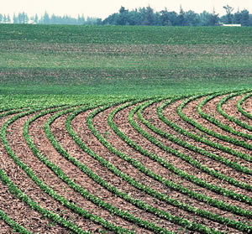
Erosion Control Methods
Contour Farming:
Farming parallel to the elevation contours vs. farming up and down the slope
Causes row crops and tillage ridges to intercept and slow down water
Can not be done in all cases

Slide 12
Erosion Control Methods
Tillage Management Practices
Not using conventional tillage (plowing under all residue)
Using conservation tillage (leaving 30% of residue) and no-till methods

Slide 13
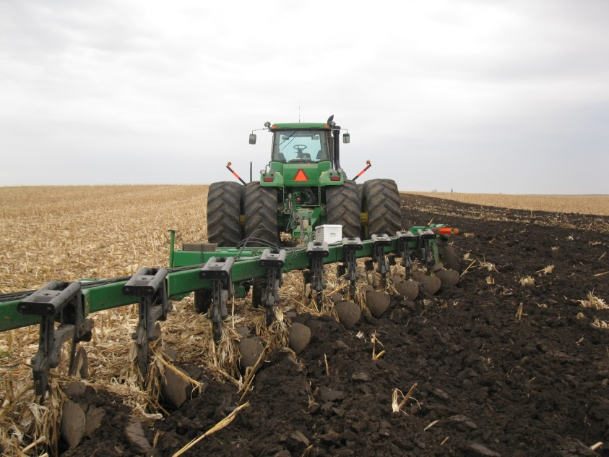
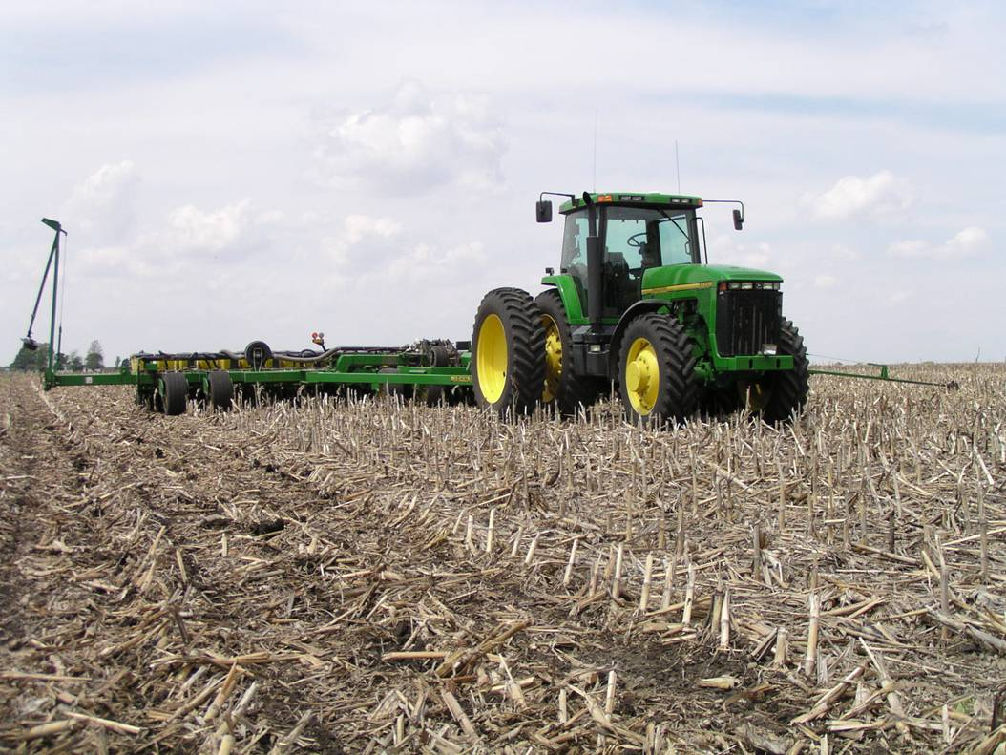
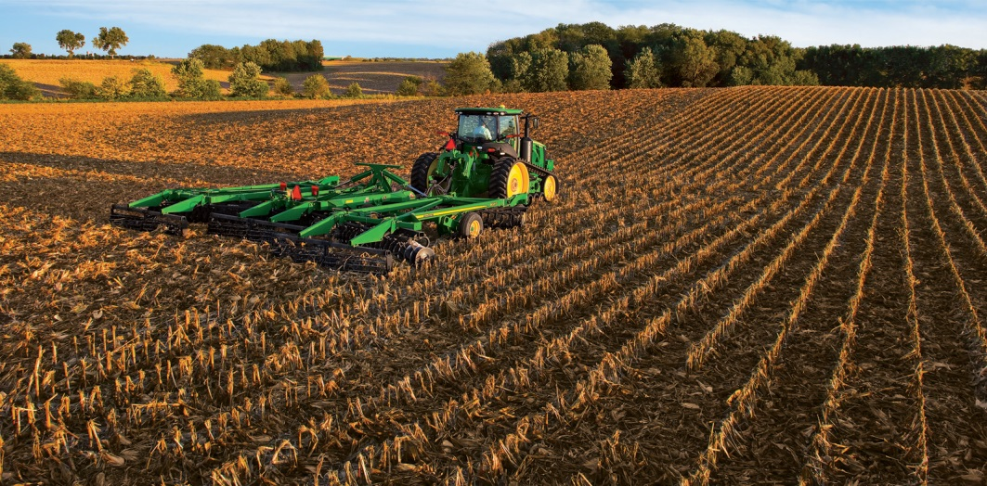
Tillage Management Practices

Slide 14
Erosion Control Methods
Tile and Dry Dam Installation
Dry dams slow water down
Tile gets the water off the surface
Generally improves crop yield as well
Dry dams require maintenance over time
https://www.youtube.com/watch?v=UxHYwrBIyZ8

Slide 15
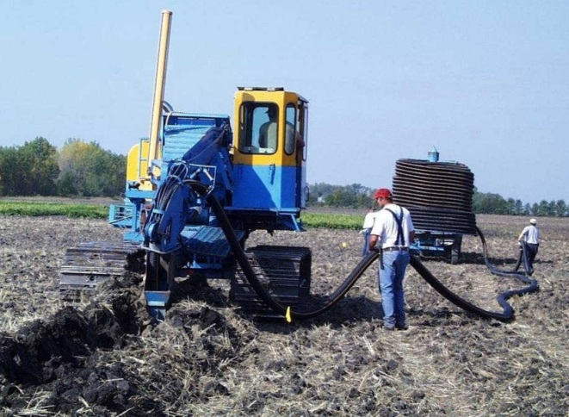
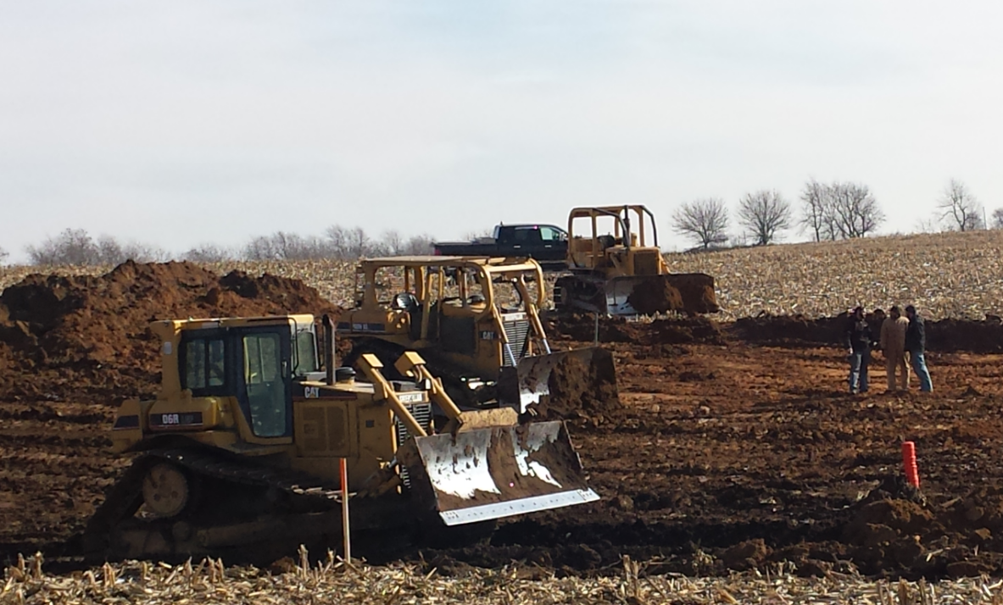
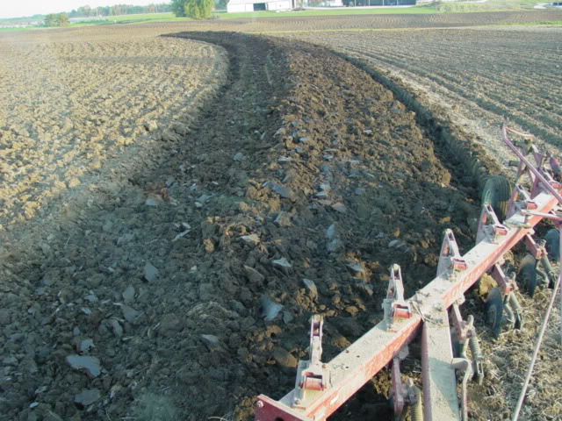
Tiling and Dry Dams

Slide 16
Erosion Control Methods
Natural Vegetation Cover
Waterways slow erosion
Leaving forest and grass strips along gullies and streams can slow erosion and slow nutrient loss
Roots anchor soil along streams
Cover crops

Slide 17
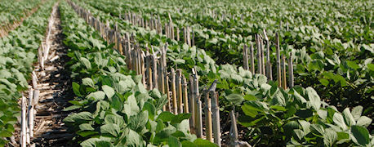
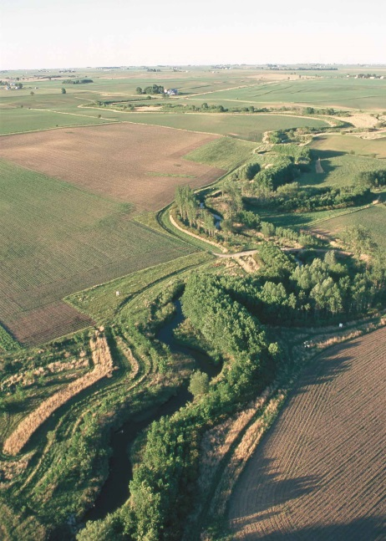
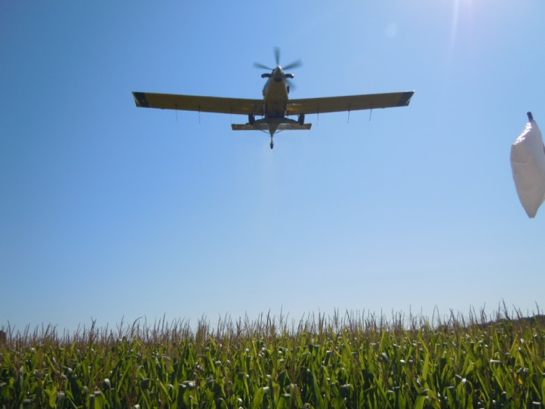
Vegetative Cover

Slide 18
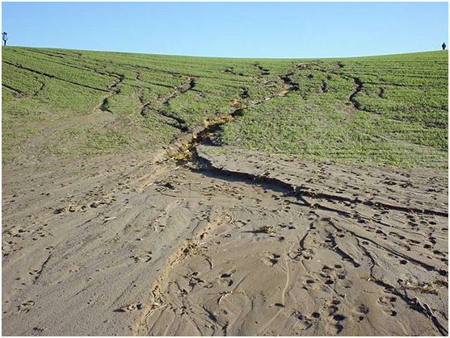
In Conclusion
Soil erosion is a major problem affecting farmers
Needs to be kept in check before it becomes a unmanageable
Many methods to control erosion that work good
https://www.youtube.com/watch?v=EzKyi4KuOEE

