Slide 1
TSM 352 Indonesia Land & Water Analysis
Nevin Liauw

Slide 2
Why Indonesia?
My homeland
Further knowledge about my own country
Expose you all to a different land and water types, problems, and solutions than Illinois

Slide 3
Objective
Background Information
Agriculture
Analyze the general land and water potentials
Land and water problems
Policy/ Solutions on land and water development

Slide 4
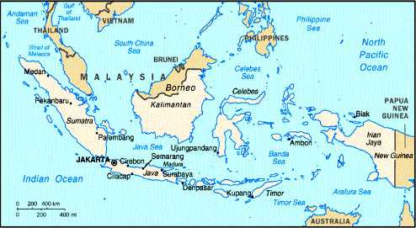
Map of Indonesia
Archipelago
Around 17,000 islands
5 major islands

Slide 5
Land use in Indonesia
No. | Type of use | Size (ha) | Proportion (%) | Biggest province
1 | Permanent forest | 111 713 000 | 66.35 | Irian Jaya
2 | Plantation | 13 045 811 | 7.75 | West Kalimantan
3 | Dry-land | 11 244,722 | 6.68 | East Java
4 | Woodland | 9 506 558 | 5.65 | West Kalimantan
5 | Wetland | 8 439 305 | 5.01 | West Java
6 | Fallow land | 6 920 650 | 4.11 | West Kalimantan
7 | Housing | 5 005 739 | 2.97 | East Java
8 | Grassland | 1 892 778 | 1.12 | East Nusa Tenggara
9 | Dyke | 407 379 | 0.24 | South Sulawesi
10 | Pond | 199 574 | 0.12 | South Sumatra
 | Total | 168 375 516 | 100

Slide 6
Soils and Topography
Several major soils
Andosol: horticulture and plantation crops Java
Latosol
Regosol: Kalimantan, not for dry-land farming
Rendzina
Lateritic
Grumosol: High calcium, lowlands for growing crops
Blue Hydromorph
Alluvial
Podsol

Slide 7
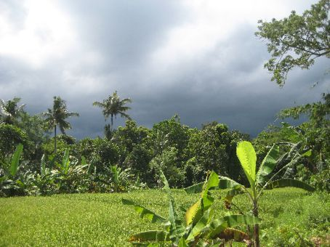
Climate
Wet and dry seasons
Dry from June to September, dry wind blows from Australia
Wet from December to March, monsoon blows from Asia and Pacific Ocean
April to May and October to November, rainfall ranges from 1,000 mm to 3,500 mm, 67-200 rainy days annually

Slide 8
Land use Classes
Class I flat, deep soil, suitable for all kinds of agriculture; particularly food crops Class II slightly sloping, sensitive to erosion. With terracing it can be used for annual and perennial crops Class III sloping land, shallow soil. With terracing, cover crop and crop rotation it can be used for perennial crops Class IV land with 15 – 30% slope. Food crops rotated with cover crops for forage and green manure for 3 – 5 years Class V flat land, permanently waterlogged. Unsuitable for crops but can be used for forage and fodder productions Class VI land with 30 – 45% slope. Unsuitable for crops. Can be used for permanent forage and fodder Class VII land with 45 – 65% slope. Can be used for forage and fodder or forestry with strategic lopping to prevent soil erosion. Class VIII land with more than 90% slope. It should not be used for forage, fodder and wood production, but kept as natural vegetation and protected forest.

Slide 9
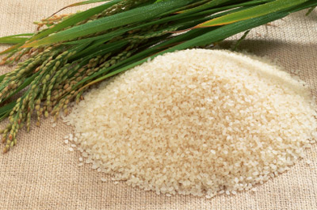
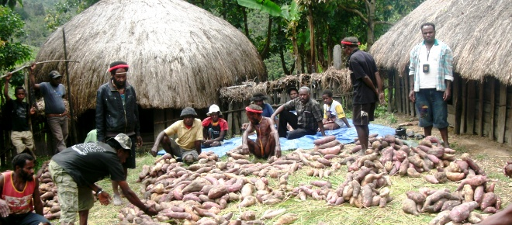
Agriculture
Consistent monsoon climate & rainfall distribution= same types of crops grown throughout the country
Only a fifth is devoted to crop cultivation
Most land dedicated to rice
Java: northern and central is rice, eastern drier region is corn, cassava, sweet potatoes, peanuts, soybean
Sumatra: tobacco, rubber, palm oil, tea, etc

Slide 10
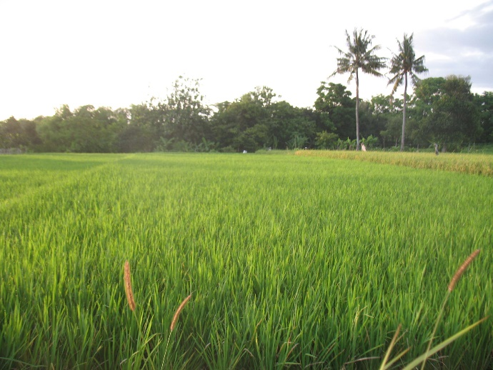
Agriculture statistics
45% of Indonesian workers, 17% of GDP in 2001
Rice is the main staple crop: 50,461,000 tons in 2001
Cassava (15,422,000 tons), corn (9,139,000 tons), sweet potato (1,928,000 tons)
Vegetable: cabbage (1,366,410 tons), shallots (772,818 tons), mustard greens (454,815 tons)
Sugar largest commercial crop (26,000,000 tons)

Slide 11
Land and Water background
Abundantly available to develop more productive agricultural activities
Agriculture important to sustain and provide staple food for Indonesia.
Great potential to produce high value commodities for export increase national foreign exchange earnings
Indonesia's 1945 National Constitution stipulates that “Land and water and all natural resources underneath are under the control of the government and [are to be] exploited as much as possible for the prosperity of the whole nation.” (Article 33)

Slide 12
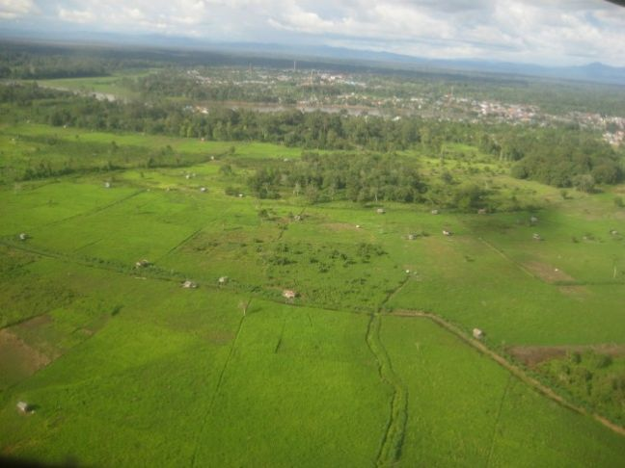
Land Resources
Land: 192 million ha total. Paddy rice accounts for 11 million ha
Technical irrigation areas (3.4 million ha)
Semi-technical irrigation areas (1.12 million ha)
Simple irrigation areas (0.77 million ha)
Village irrigation (2.29 million ha)
Inland and tidal swamp (1.67 million ha)
Rainfed areas (1.77 million ha)
Dryland and non-irrigated areas (57 million ha)

Slide 13
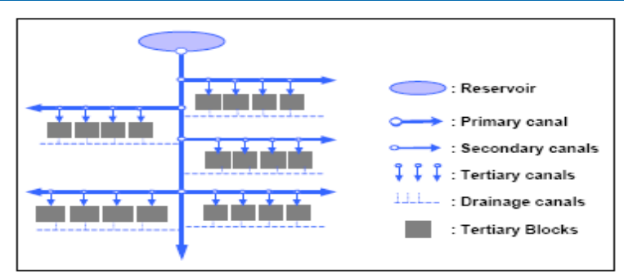
Technical and semi irrigation
Permanent structure, measure and control water flows.
Main, secondary, and tertiary canals, deliver water to tertiary block

Slide 14
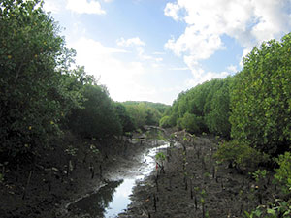
Water resources
Central input for agriculture production.
2000-3500 mm annual rainfall, 278 mm infiltrates and percolates as ground water. Remaining runoff or surface water.
If managed properly, readily available 2100 mm annually
Water storage total= 13.75 million ha, lake (1.77 million ha), dam and reservoir (50,000 ha), rivers (2.9 million ha), inland/swamp (9 million ha)

Slide 15
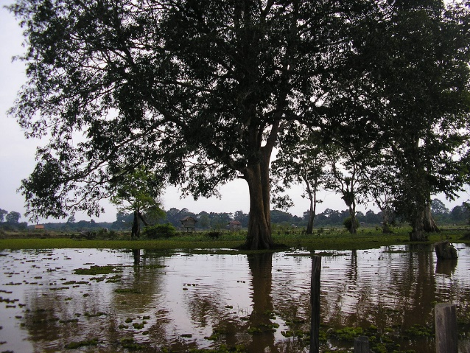
Land resources problems
Transformation of productive agriculture areas into critical land: 8 million ha
Marginal land: swamp ecosystem, 24 million ha
Sleeping land
Conversion of paddy rice land: 246,000 ha affected
Land fragmentation
Infrastructure development of optimal irrigated areas.

Slide 16
Water resources problems
Rising water demand: quality and quantity
Lack of upland/upstream land management
Erosion-related degradation
Population growth
Inefficient irrigation water management
Extreme climatic change
Over-pumping of groundwater
Weak water user associations

Slide 17
Policy on land resources development
Critical land: develop upland farming conservation practices to farmers
Marginal land: manage marginal land and carry out land improvement
Sleeping land: transmigration program, mechanized agriculture,
Conversion of land function
Land fragmentation
Staged infrastructure development toward irrigated land

Slide 18
Policy on water resources development
Conserve water
Encourage national water saving movement
Carry out reforestation and regreening
Improve operation and maintenance
Prevent water resources pollution from domestic and industrial waste
Increase efficient use of irrigation water
Anticipate climate changes
Prevent groundwater pollution
Improve performance of water user associations

Slide 19
Conclusion
In order to improve our rice-self sufficiency and agriculture, land and water resources problems must be faced.
This will lead to improve production in agriculture
Improve economical and political position in the world
Sustain our country

Slide 20
Works cited
http://www.fao.org/docrep/005/ac623e/ac623e0g.htm
https://www.uni-due.de/imperia/md/content/water-science/irrigation_and_irrigation_problem_in_indonesia.pdf
http://www.fao.org/ag/AGP/AGPC/doc/Counprof/Indonesia/Indones.htm
http://www.nationsencyclopedia.com/Asia-and-Oceania/Indonesia-AGRICULTURE.html
http://www.britannica.com/EBchecked/topic/286480/Indonesia/22860/Agriculture-forestry-and-fishing

