Slide 1
Successful Golf Course Drainage
Dimitri Lazaridis and Philip Appleton

Slide 2
Introduction
Natural precipitation leads to unwanted water on golf course
Controlled removal through surface drainage
Controlled drainage = healthy turf grass, better course playability
Drainage necessary because some soils do not drain fast naturally

Slide 3
Successful Course Drainage
Contour the course to create miniature hills
Take rainfall frequency and intensity into account during design
Some areas receive rain more frequently and intensely
Design drainage system based on return period
Return periods between 25-50 years desirable for course drainage systems
Return period: Likely number of years between a given intensity event

Slide 4
Course Runoff
Intensity > infiltration, runoff occurs
Infiltration dependent on soil texture (% sand, silt, and clay)
Heavy textured soils have lower infiltration rate
Important to eliminate hollows and divert runoff on golf course

Slide 5
Flow Velocity as Function of Slope
Runoff dependent on ground slope and turf characteristics
High density grass has slower flow velocity for a given slope
Bluegrass less dense than Bermudagrass

Slide 6
Golf Courses and Watershed Hydrology
Watershed delineation crucial in designing drainage system
Use topographical surveys or maps to map watersheds
Golf course divided into separate watersheds
Watersheds help divert runoff of course
Notes:
Recall that (Tc) is the time of concentration, the time it takes for the entire watershed to contribute to runoff.

Slide 7
course watershed layout example
Notes:
Golf course landscape is subdivided into collection of watersheds or catchments.
Additional watersheds can be created to divert runoff of the fairway or other parts of the course
Remember, a watershed is an area of land that contributes water to a single point of discharges such as a stream, lake, or pond

Slide 8
Soil compaction
Soil compaction and loss of drainage interrelated
Most serious damage that can occur to golf courses
Loss of Macropore space results in downward spiral
Notes:
High foot traffic after rain results in compaction and loss of the soils Macropores. Next time it rains it gets worse. Cyclical degradation of soil structure

Slide 9
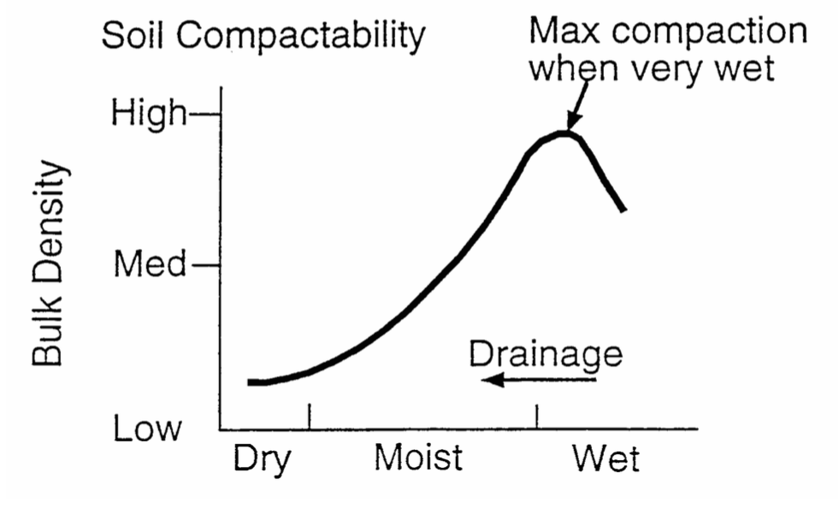
Soil Compaction
Golf course integrity dependent on low soil compaction
Saturated soils have higher bulk density (highly compacted)
Causes plugging, tire rutting, carts getting stuck
Sandy soils preferable
Notes:
Plugging- golf ball impacted in soil
tire rutting-leaves permanent tracks through the turf
Sandy soils preferable because they are non cohesive (high compressive strength) and their soil structures do not rely on moisture. Used in tee boxes, greens, and high traffic areas

Slide 10
Rutting

Slide 11
Plugging

Slide 12
Surface drainage
Must ensure drainage structures are designed to handle anticipated storm flow
Installed drainage often larger than required
Examples
Drainage ditch larger to avoid mower scalping (smaller slope)
3 inch pipe adequate, but 4 inch pipe is cheaper
Drainage guidelines are more important in large drainage areas
Key step in design is determining the peak runoff rate
Q=CIA
Notes:
In small drainage areas, like greens and isolated fairways, drainage guidelines are not important.
But in areas such as large, wide fairways, these drainage requirements play a greater role.

Slide 13
Drainage Ditch
Notes:
Left: Drainage ditch under construction
Right: Drainage ditch designed to look natural

Slide 14
Drainage Ditch Design
Notes:
explanation

Slide 15
Drainage Ditch design

Slide 16
Subsurface drainage
Used to drain soils and avoid soil saturation
Consists of a series of drain tiles
Designed to create uniform drainage across fairways, greens, and teeboxes
Notes:
Note: Ground penetrating radar used to map subsurface drainage

Slide 17
Green Drainage Layout example
Drainage Installation

Slide 18
Sizing Fairway drainage pipes
Size pipes given info below:
Corrugated plastic pipe
Slope: 1.5%
4 laterals: 650ft length, 20ft spacing
2 in/day drainage coefficient

Slide 19
Sizing fairway drainage pipes 2
Calculate drainage area per lateral: 650x20=13,000ft² = 0.3 acres
From chart, size laterals:
Min. Lateral pipe D = 2”
Discharge = 11 gpm
V~1.5 ft/sec (diagonal lines)
Sizing mains, take into consideration:
Drained area from each lateral contributes to mains
Flow rate increases for each section of main

Slide 20
Sizing fairway drainage pipes 3
All laterals are 2” minimum diameter
First main section needs 2” pipe,
Second needs 3” pipe
Third main needs 3” pipe
Fourth main needs 4” pipe
However, why join different diameter sections? Easier to use 4” throughout the mains
D=2”
D=2”
D=2”
D=3”
D=2”
D=3”
D=2”
D=4”

Slide 21
In conclusion
Keys to create a successful golf course drainage system
Determine Peak Runoff Rate using Q=CIA and by finding the Time of Concentration
Determine type and quantity of drainage systems to use
Determine materials required
Build systems and observe results

Slide 22
Works Cited
Atlantic Subsurface Imaging. Accessed March 27, 2015. http://www.atlanticsubsurfaceimaging.com/golfscan.html
McCoy, Dr Ed. “Drainage Systems for Golf Courses. Accessed March 27, 2015https://kb.osu.edu/dspace/bitstream/handle/1811/65469/SENR_mccoy_golf_courses_DrainageSystems.pdf?sequence=2
Multi Flow Drainage Systems. Accessed March 27, 2015. http://www.multi-flow.com/Menu/golf_course_installation.html

