Slide 1
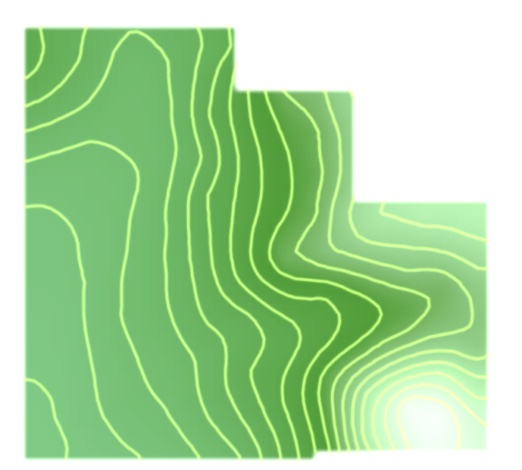
Map Projections

Slide 2
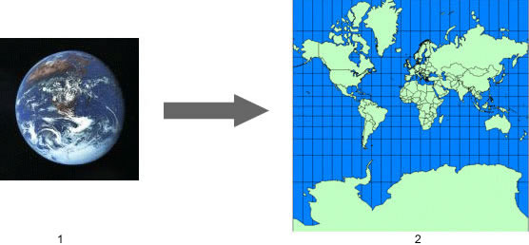
What is a Map Projection?
A mathematical expression used to represent the 3D surface of the earth on a 2D map
Always results in distortions
Source: http://support.google.com/earth/bin/answer.py?hl=en&answer=148111

Slide 3
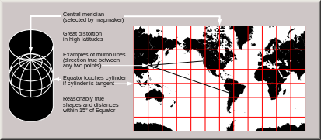
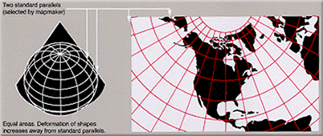
Projection Surfaces
Cylindrical
Meridians and parallels are equidistant, straight lines, crossing at right angles
Conical
Parallel(s) that are touching the cone are assigned unitary scale
Planar
Point or circle that intersects tangent plane has no distortion
Source: http://en.wikipedia.org/wiki/Map_projection#Projections_by_surface

Slide 4
Preservation of a Metric Property
Conformal- Preserves angles locally (MapWindow uses this projection exclusively)
Equal-area- Preserves area
Equidistant- Preserves distance from a standard point or line
Gnomonic- Preserves shortest route between two points (great circles projected as straight lines)
Azimuthal- Preserves cardinal directions
Compromise- Balancing/minimizing overall distortion
Source: http://en.wikipedia.org/wiki/Map_projection#Projections_by_surface

Slide 5
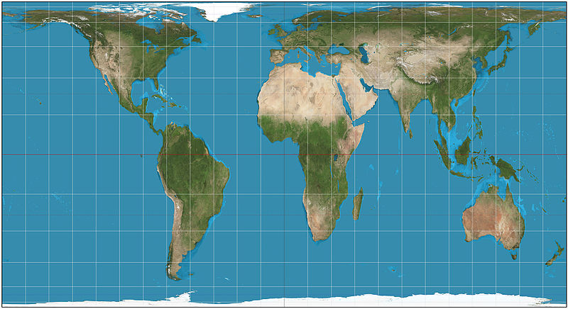
Projection Comparison
Equal Area Projection
Equal Angle Projection

Slide 6
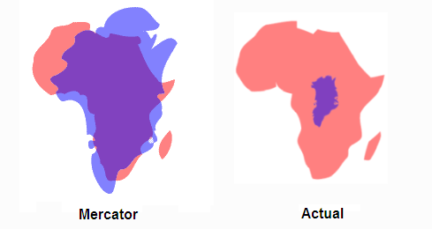
Universal Transverse Mercator
Lat/Lon WGS84 (UTM) used in Google Earth and MapWindow
Topographical maps, geological maps
Cylindrical, conformal
Large distortions at the poles
Greenland (blue) vs. Africa (red) example
Source: http://support.google.com/earth/bin/answer.py?hl=en&answer=148111
http://www.pratham.name/mercator-projection-africa-vs-greenland.html

Slide 7
Exploring Map Layers in Google Earth
Georeferencing Images

Slide 8
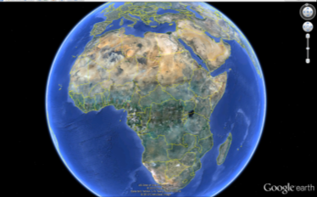
Google Earth
An interface that facilitates an exploration of geographic information from a computer
Ability to fly anywhere and view satellite imagery, maps and terrain

Slide 9
Layers in Google Earth
The layers tool allows one to choose information to display over the place of interest.
Information to choose from includes: borders, places, roads, 3D buildings, ocean, weather, locations of global organizations, volcanoes, ocean observations, photos, webcams, and much more

Slide 10
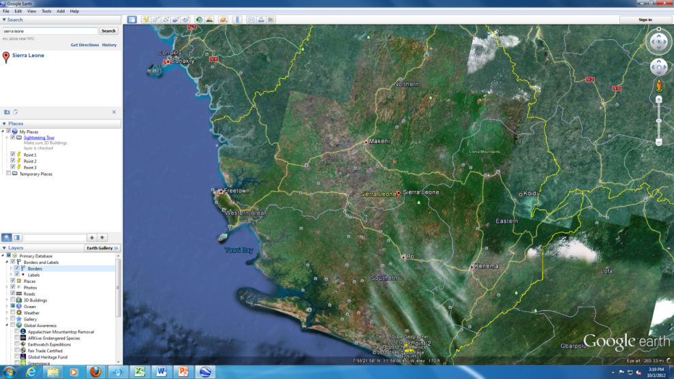
Exploring Layers
Fly to Sierra Leone by typing “Sierra Leone” in the search bar

Slide 11
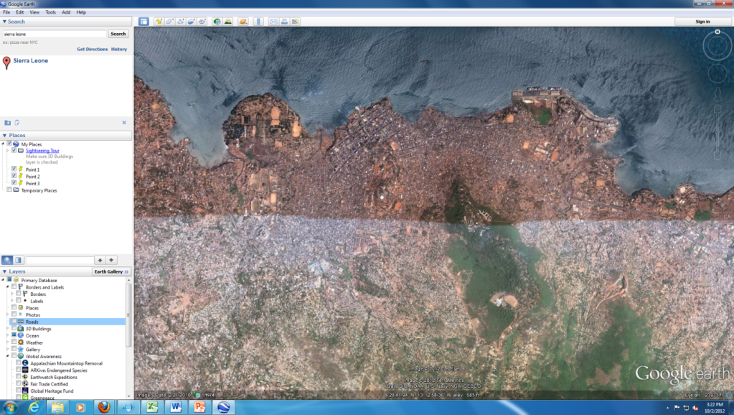
Exploring Layers
Zoom in to Freetown by double clicking on the 3D map

Slide 12
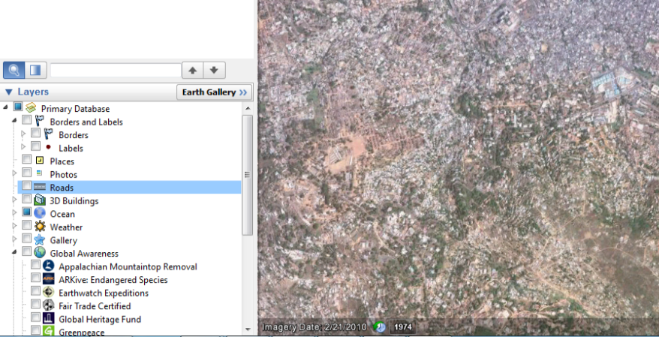
Exploring Layers
Check the boxes under the layers tab next to each category to explore available information for Freetown

Slide 13
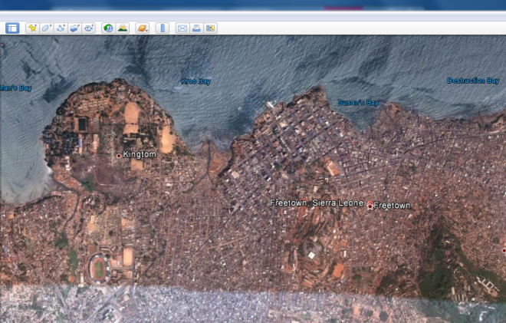
Exploring Layers: Borders and Labels
When we select the “borders and labels” layer, borders and labels appear on the map
Name of place are now labeled

Slide 14
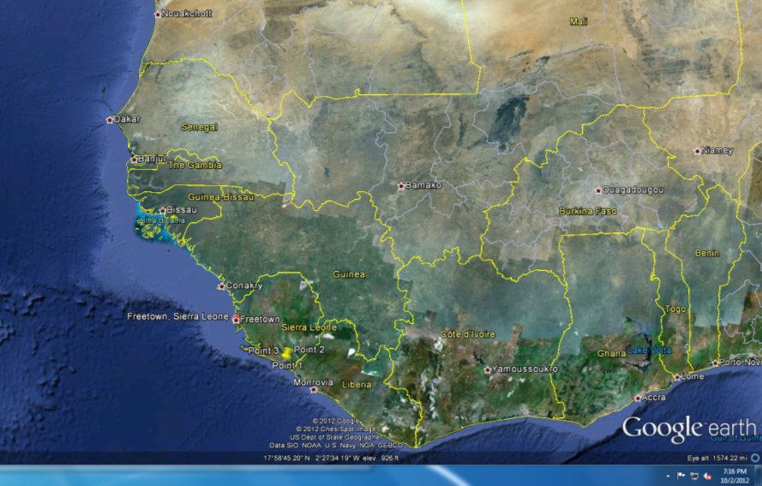
Exploring Layers: Borders and Labels
One can zoom out, and view country borders

Slide 15
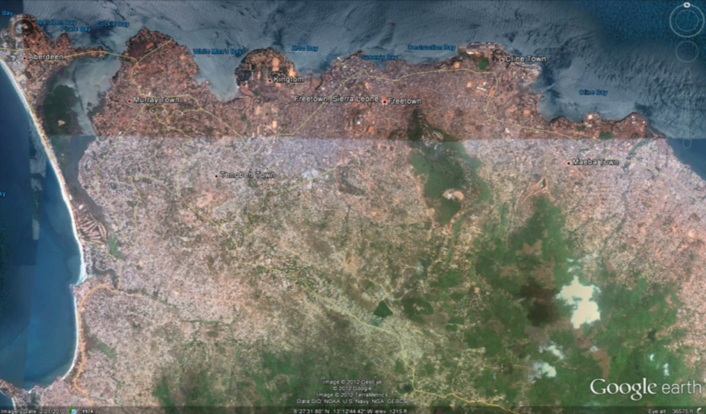
Exploring Layers: Roads
When we select the roads layer, roads appear on the map
Zoom back in for more detail

Slide 16
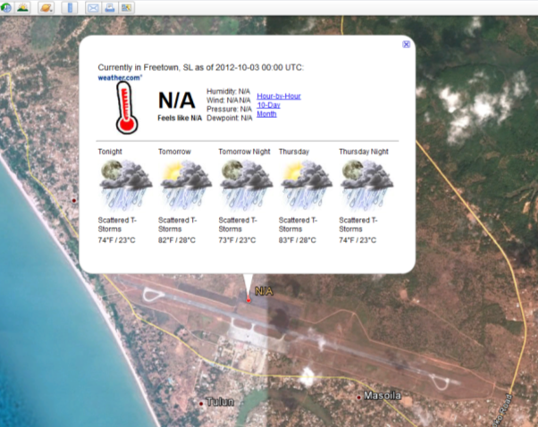
Exploring Layers: Weather
Select the weather layer and zoom out to see clouds
Locate and zoom back in on a thermometer for current weather

Slide 17
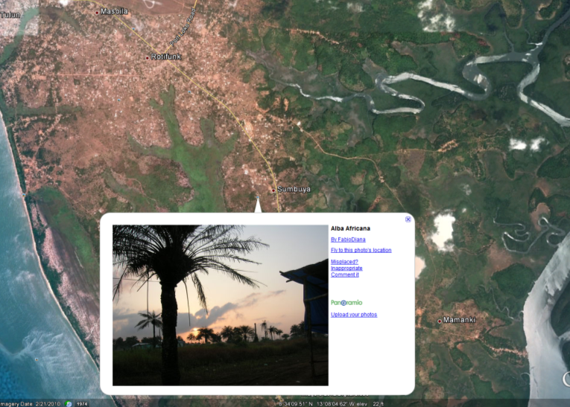
Exploring Layers: Photos
Select the photo layer and click on any one of the photo options that appears to view a photo
Click fly to location
to move to where
the photo was
taken

Slide 18
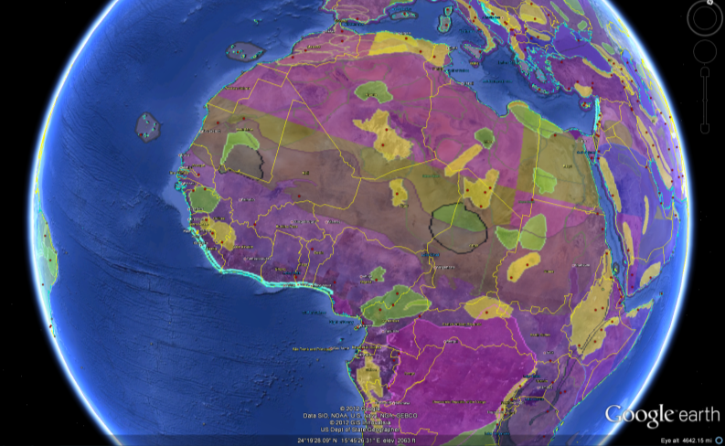
Exploring Layers
Click on Earth Gallery and Select Natural Earth Features Map
Under layers, you should now have a geographic features map
Now, geographic
features are color
coded on your map

Slide 19
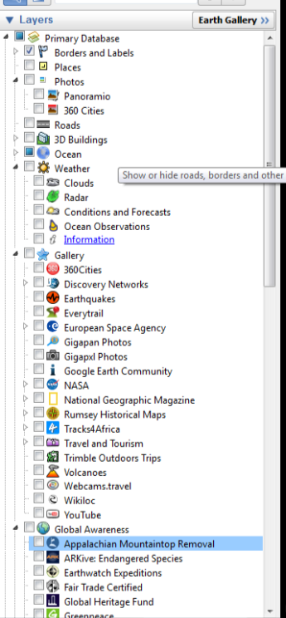
Exploring Layers
Spend time exploring other layers that interest you

Slide 20
Georeferencing an Image
You can georeference an image from Google Earth in MapWindow GIS
The tool used in MapWindow enables georeferencing an image by specifying the location of 3 points on the image

Slide 21
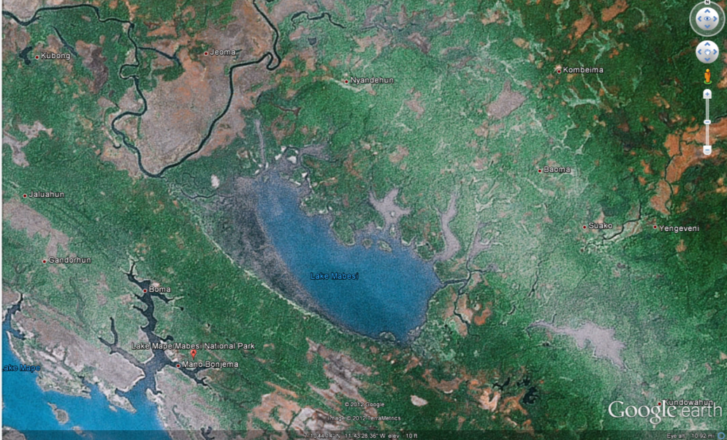
Choose a location to Georeference
Fly to Lake Mabesi

Slide 22
Select Three Points
Add 3 placemarks to the image
Note the latitude and longitude of the
3 placemark points
Use decimal degrees

Slide 23
Saving the Image
Save the Image in an uncompressed format (BMP)

Slide 24
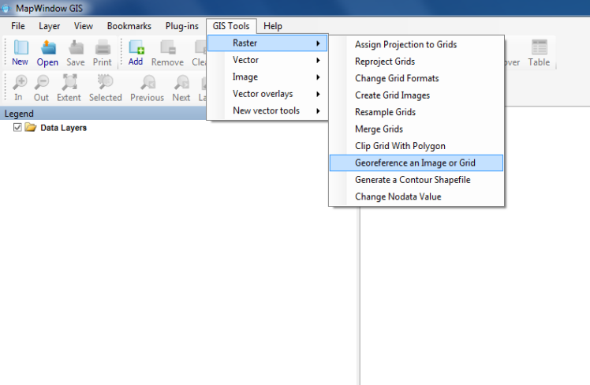
Access Georeferencing Tool in MapWindow
Access the GIS tool and click raster, then georeference an image or grid

Slide 25
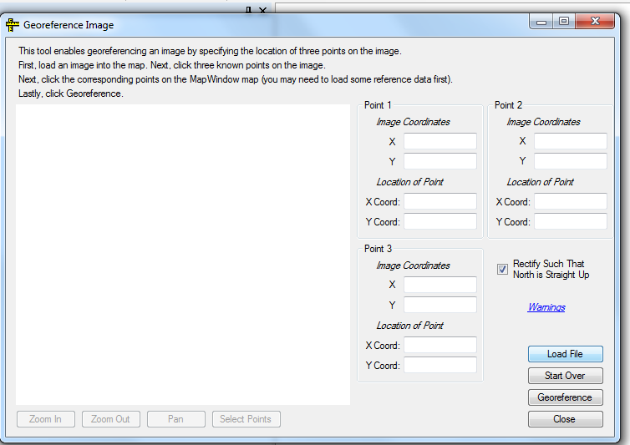
Load the Image
Load the BMP Image by selecting Load File

Slide 26
Select Noted Points
Click Select Points and then select the locations of three known points on the image

Slide 27
Type in Longitude and Latitude
Specify the location of the known points in decimal degrees

Slide 28
Click the Georeference Button
Deselect Rectify such that north is straight up and then click Georeference and then close

Slide 29
Viewing Georeferenced Image

Slide 30
Georeferenced Image

