Slide 1
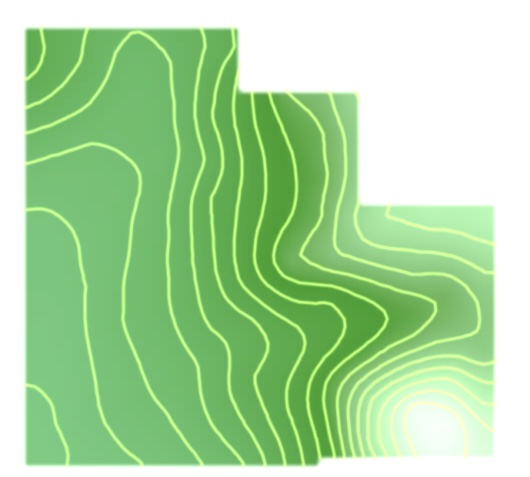
Latitude Longitude

Slide 2
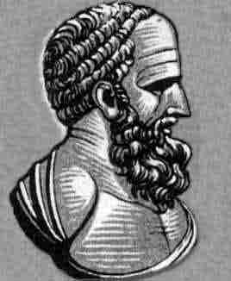
History
Use of grid lines originated from about 300 B.C.E by Greek astronomers Hipparcus and Ptolemy
Used spherical trigonometry observations using sun, moon, and stars to plot points on a spherical earth
About 225 B.C.E, Eratosthenes measured circumference of the earth.

Slide 3
History
Knowing these dimensions, latitude was easily calculated.
Measured sun’s angle at noon relative to the equator.
Noon was determined simply from the highest point of the sun.
Longitude was much harder to calculate, however

Slide 4
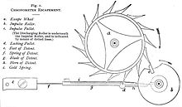
History
East-west distance from one place to another on the earth could be plotted from position of sun and stars, but only if the time difference between the two places was known.
Inexact until invention of telescope and an accurate clock in the 16th century
1760, John Harrison invented an exact marine chronometer.

Slide 5
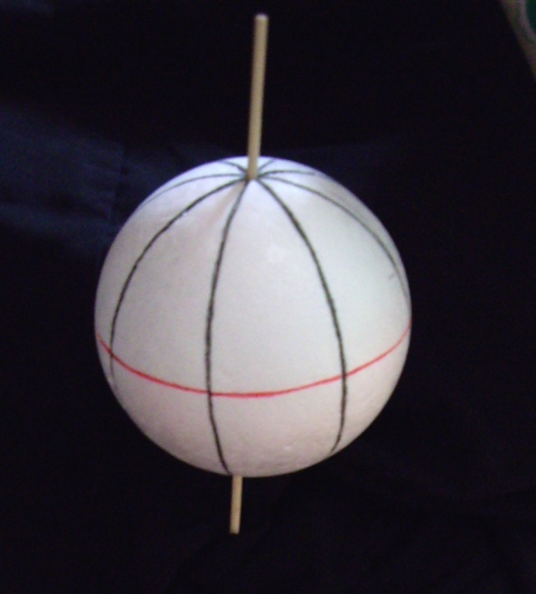
Lines of
longitude only
Equator added
Other lines of latitude added

Slide 6
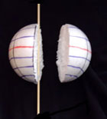
Cross-section through line of longitude
Cross-sections through lines of latitude

Slide 7
Latitude
“Lat is Flat”
Latitude lines run horizontally and are also known as parallels
Each degree of latitude is approximately 69 miles apart, but there is some variation due to the earth being an oblate ellipsoid.

Slide 8
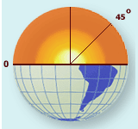
Latitude
Equator is latitude line of 0 degrees.
Values indicate angular distance between Equator and points north or south of the surface of the Earth
Degrees latitude are numbered from 0 – 90 north and south (90N is North pole; 90S is South pole)

Slide 9
Longitude
Longitude lines run vertically and are also called meridians.
Converge at poles and are widest at equator
Zero degrees longitude is located at Greenwich, England. Established in 1884. “Prime meridian”.

Slide 10
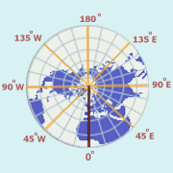
Longitude
Degrees continue 180 degrees east and 180 degrees west where they meet and form the International Date Line

Slide 11
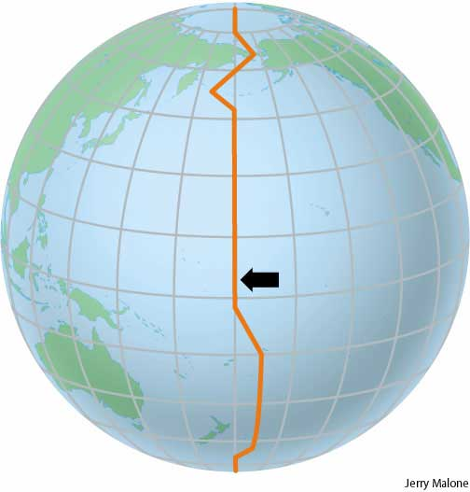
International Date Line
America to Asia –
gain a day
Asia to America –
lose a day

Slide 12
Precision
Degrees of latitude and longitude can be further subdivided into minutes and seconds.
60 minutes per degree (‘)
60 seconds per minute (“)
Ex. 40°06'36.88"N 88°13'38.13"W

Slide 13
Precision
Values can be also be expressed as decimals:
Ex. 65.5375
Degrees and decimal minutes:
Ex. 65⁰ 32.25’
Degrees, minutes, decimal seconds:
Ex. 65⁰ 32’ 15.275”
Accurate to within inches.

Slide 14
Precision
A typical coordinate pair of latitude and longitude would read:
Ex. 40°06'36.88"N 88°13'38.13"W(Quad)
This can also be written using negative values. When directional designators are not used, northern latitudes are positive, southern latitudes are negative. For longitude, 180 degrees east of P.M. are positive, 180 degrees west of P.M. are negative.
Ex. 40°06'36.88“, -88°13'38.13"

Slide 15
Example
Give a rough estimate of the latitude and longitude coordinates of Sierra Leone
Use map on following slide

Slide 16
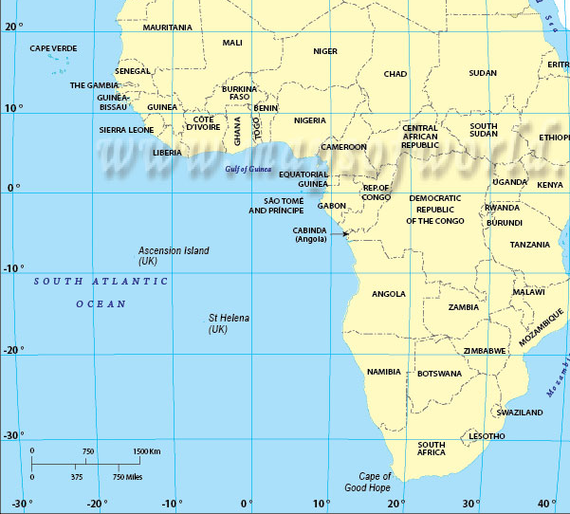
Answer: 8°N, 12°W

Slide 17
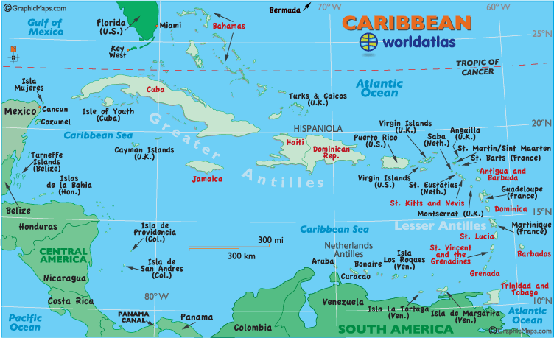
Example
Please help me. I need to find the island that is located at about 18.3° N, 66.4° W.

Slide 18
No, it’s not Jamaica.
Answer: Puerto Rico.

