Slide 1
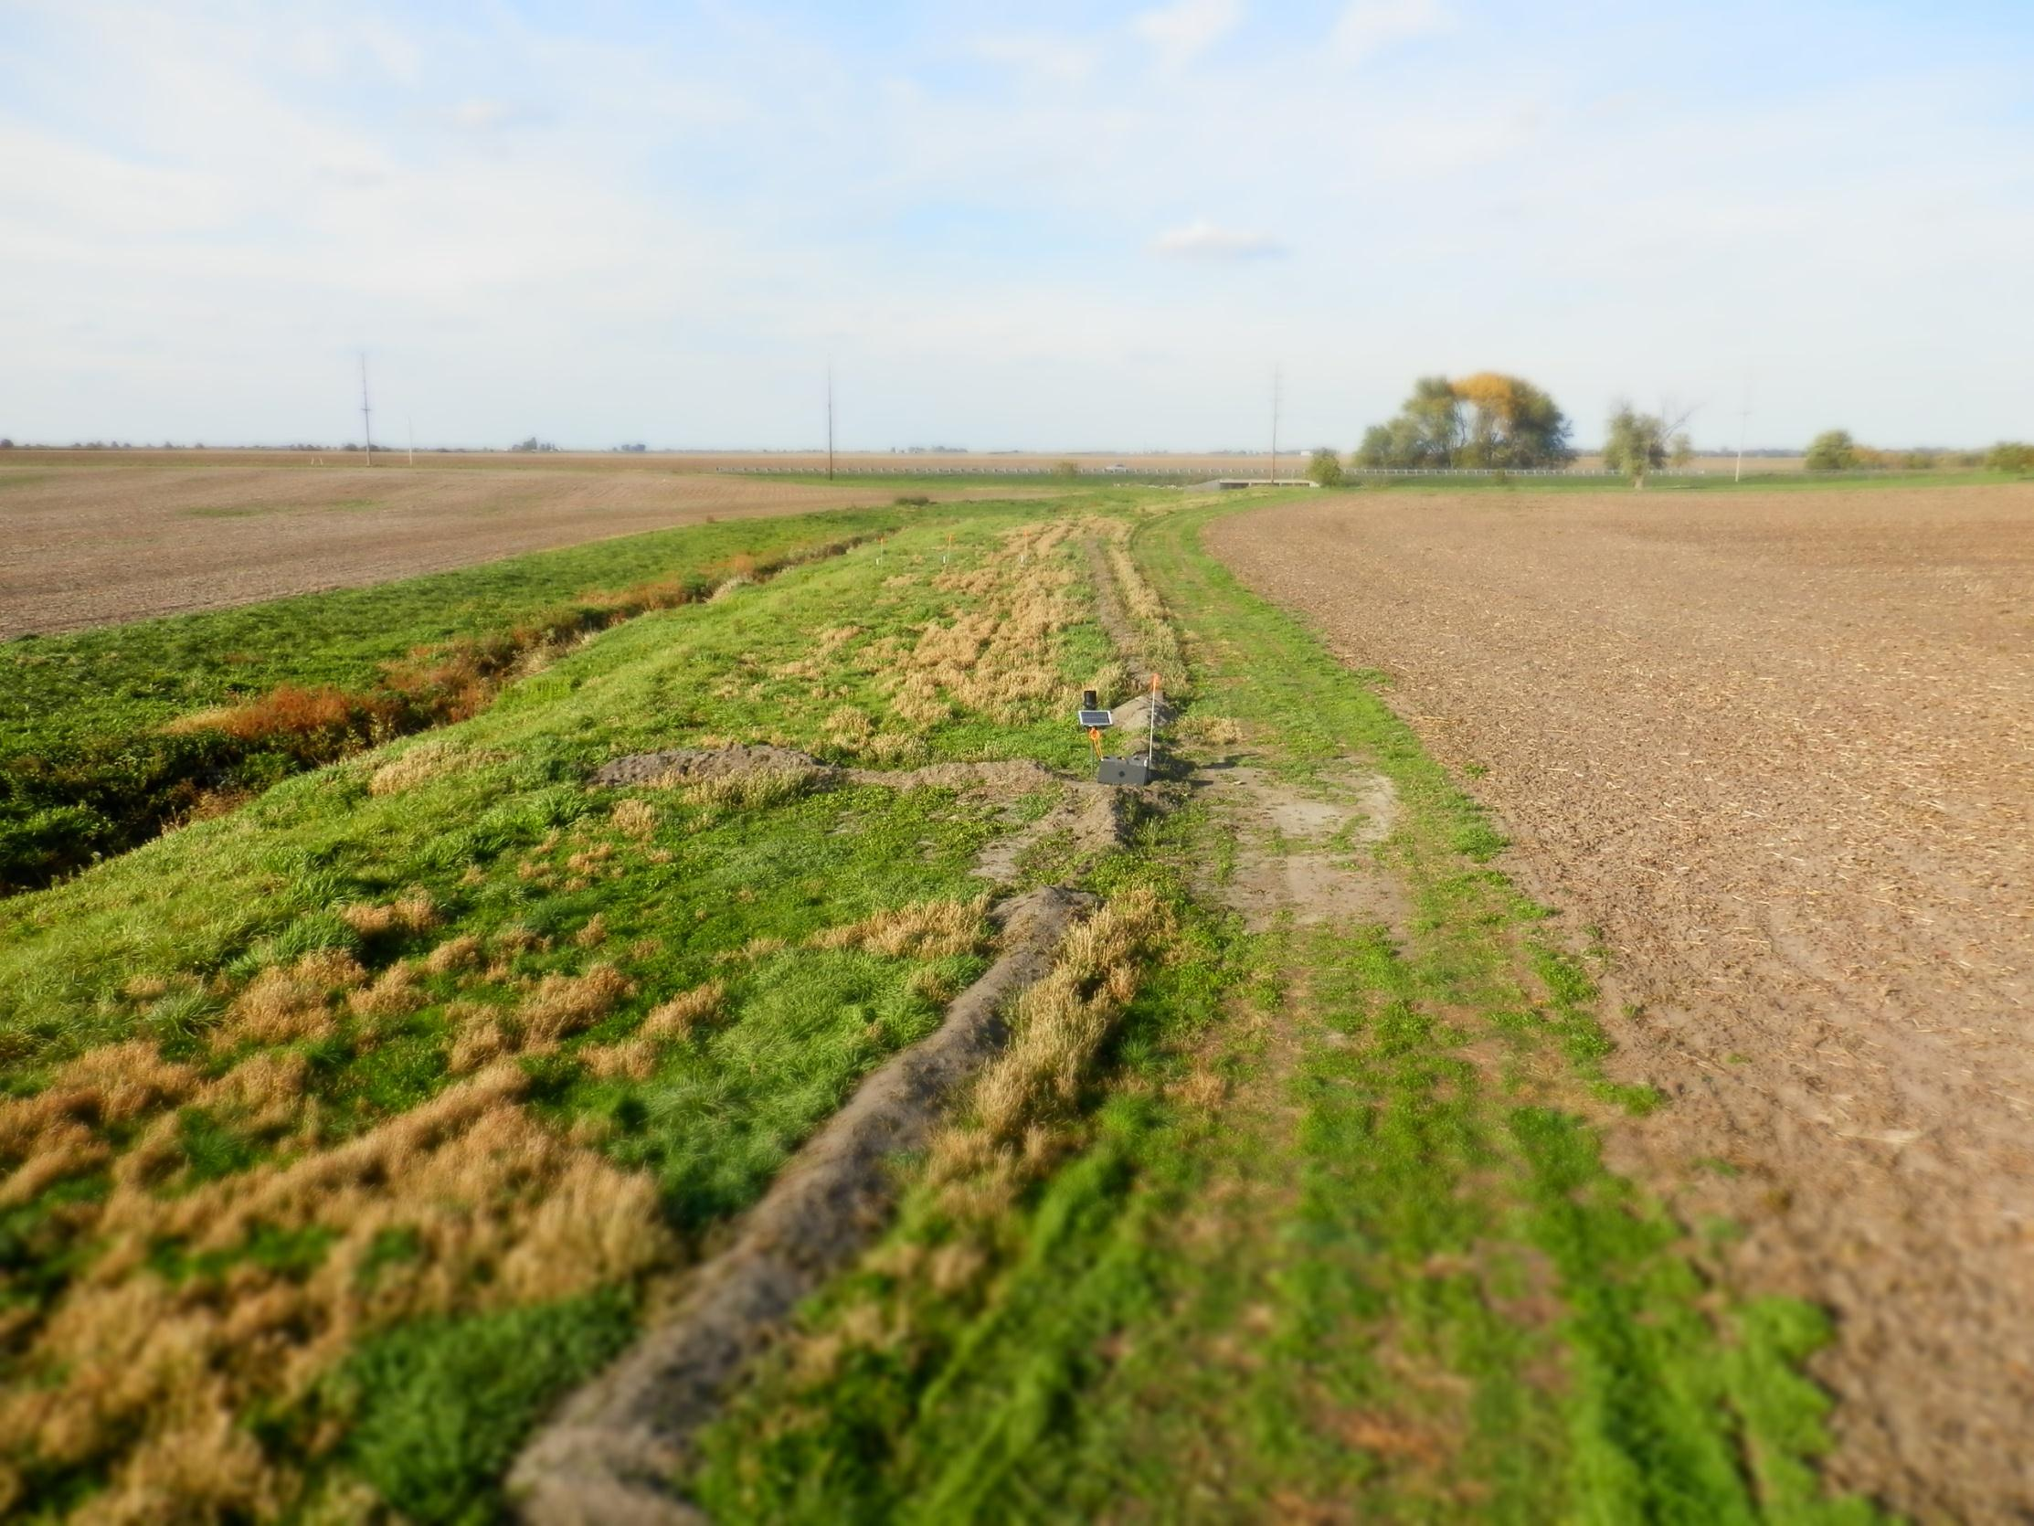

Conservation Drainage:
Solutions for Subsurface Nutrient Transport

Slide 2
HYDROLOGIC CYCLE (with tiles)

Slide 3
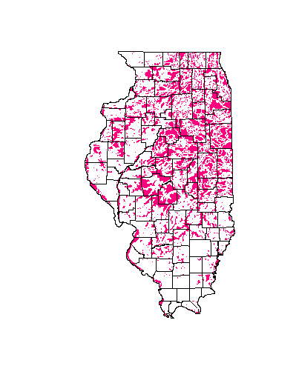
Distribution of Subsurface Tile
Drainage in Illinois
3-4 million ha (6-10 million
acres) drained with
subsurface tile in
Illinois
This comprises some
of the most productive
agricultural land in the
US.

Slide 4
The Nitrate Saga
1890s
Scientists sound alarm about
need for new source of nitrates

Slide 5
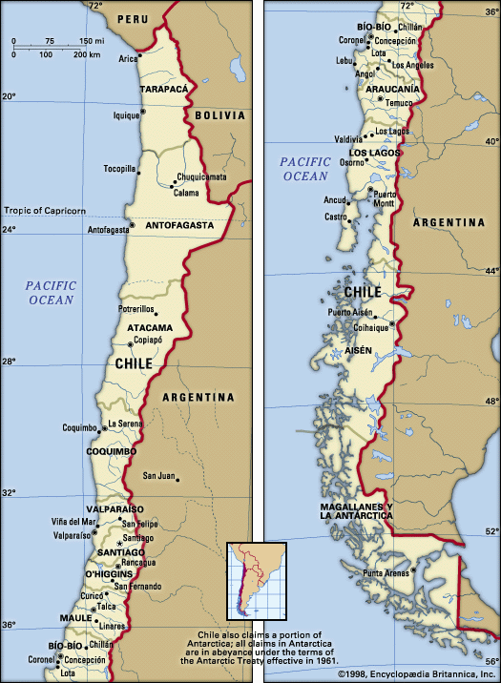

Slide 6
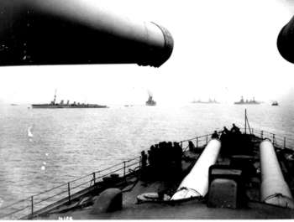

Slide 7
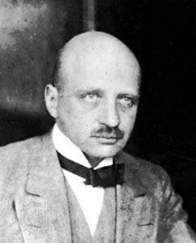
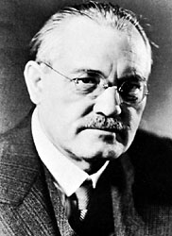
Fritz Haber
Carl Bosch

Slide 8
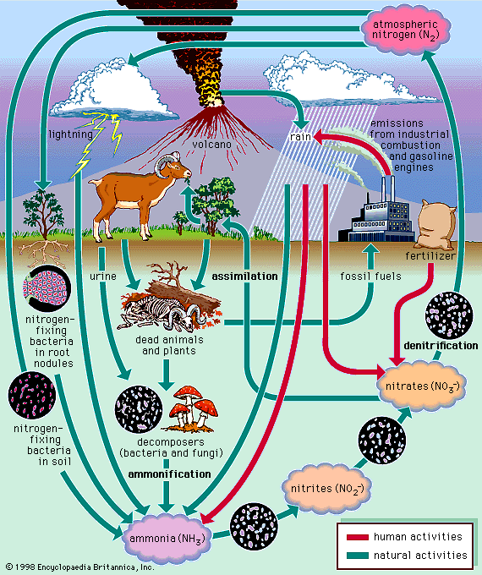

Slide 9
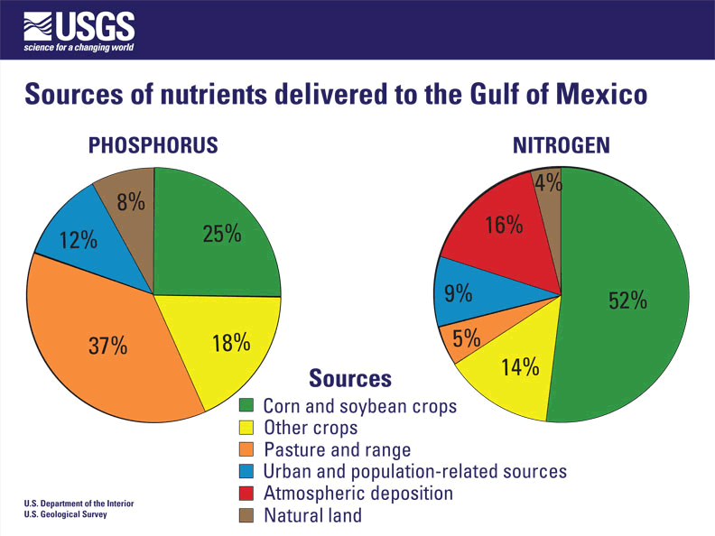

Slide 10
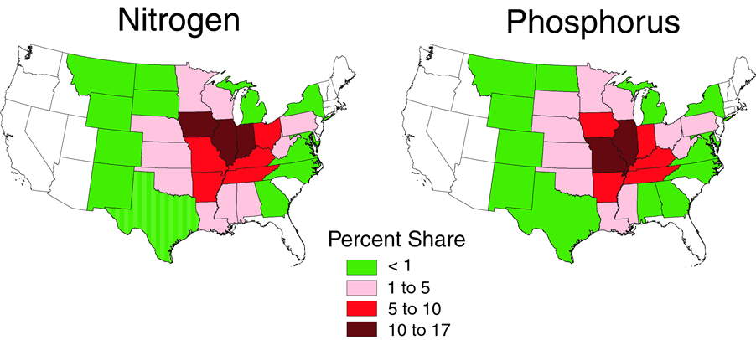
Nutrient contributions to the Gulf, by State

Slide 11
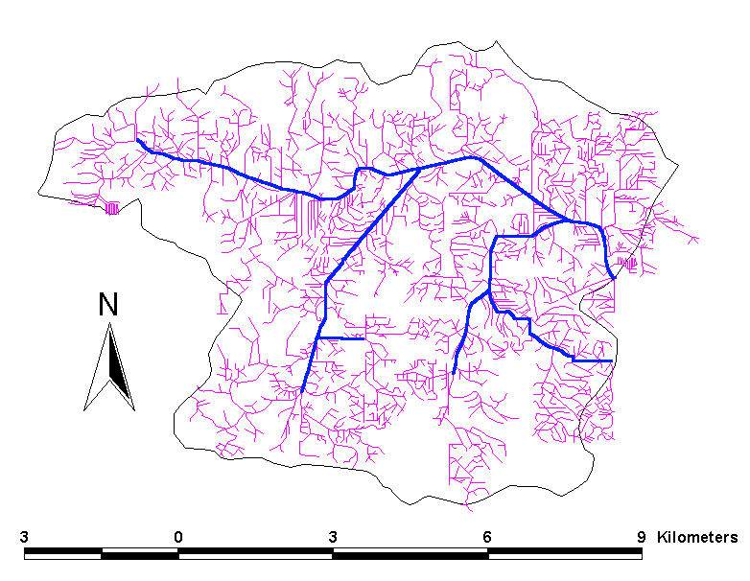
7.2
km/km²

Slide 12
Nitrate Reduction Techniques
Altering Nitrogen Application Amounts
Altering Nitrogen Application Timing
Edge-of-Field Treatment
Optimizing Drainage System

Slide 13
Conservation
Drainage
The optimization of drainage systems for crop production, water quality and water harvesting benefits

Slide 14
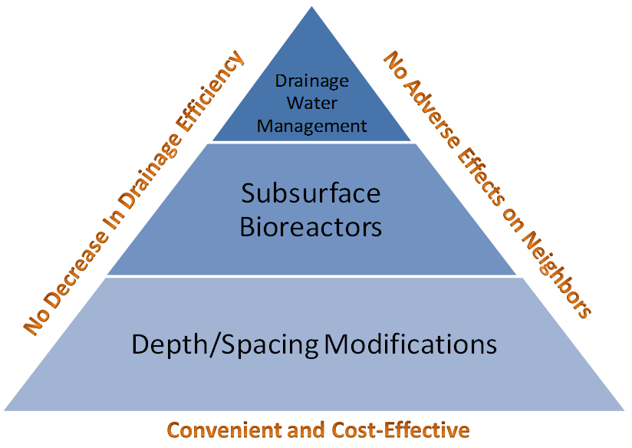
Conservation Drainage Practices

Slide 15
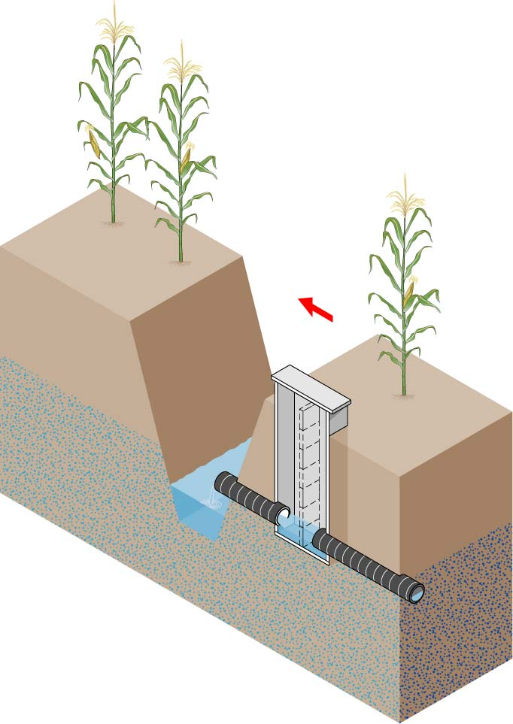
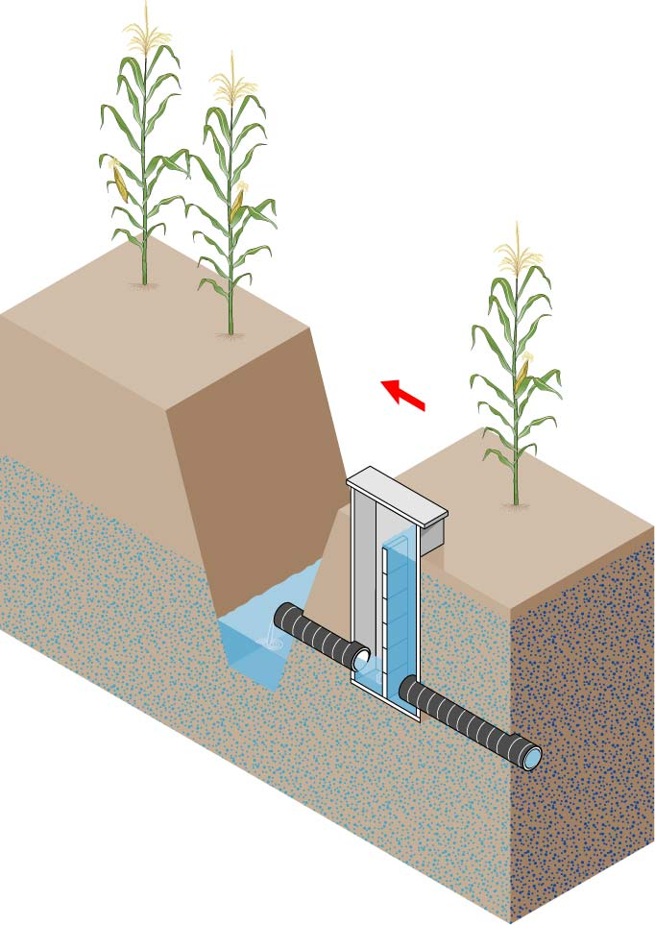
Drainage Water Management

Slide 16
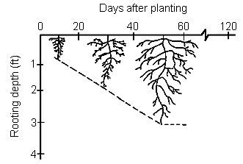
Drainage water management system operated
for both water quality and yield benefits
10/31
12/31
2/28
4/15
5/18
7/7
8/26
10/15
Soil Surface
0
Outlet Depth
6
12
18
24
Outlet set close
to soil surface during
fallow period
Outlet set to
Drainage Outlet Depth (in)
Planting
mirror root growth
30
Harvest
36
42
Potential water storage
during growing season
48
Subsurface Drain Depth
54

Slide 17
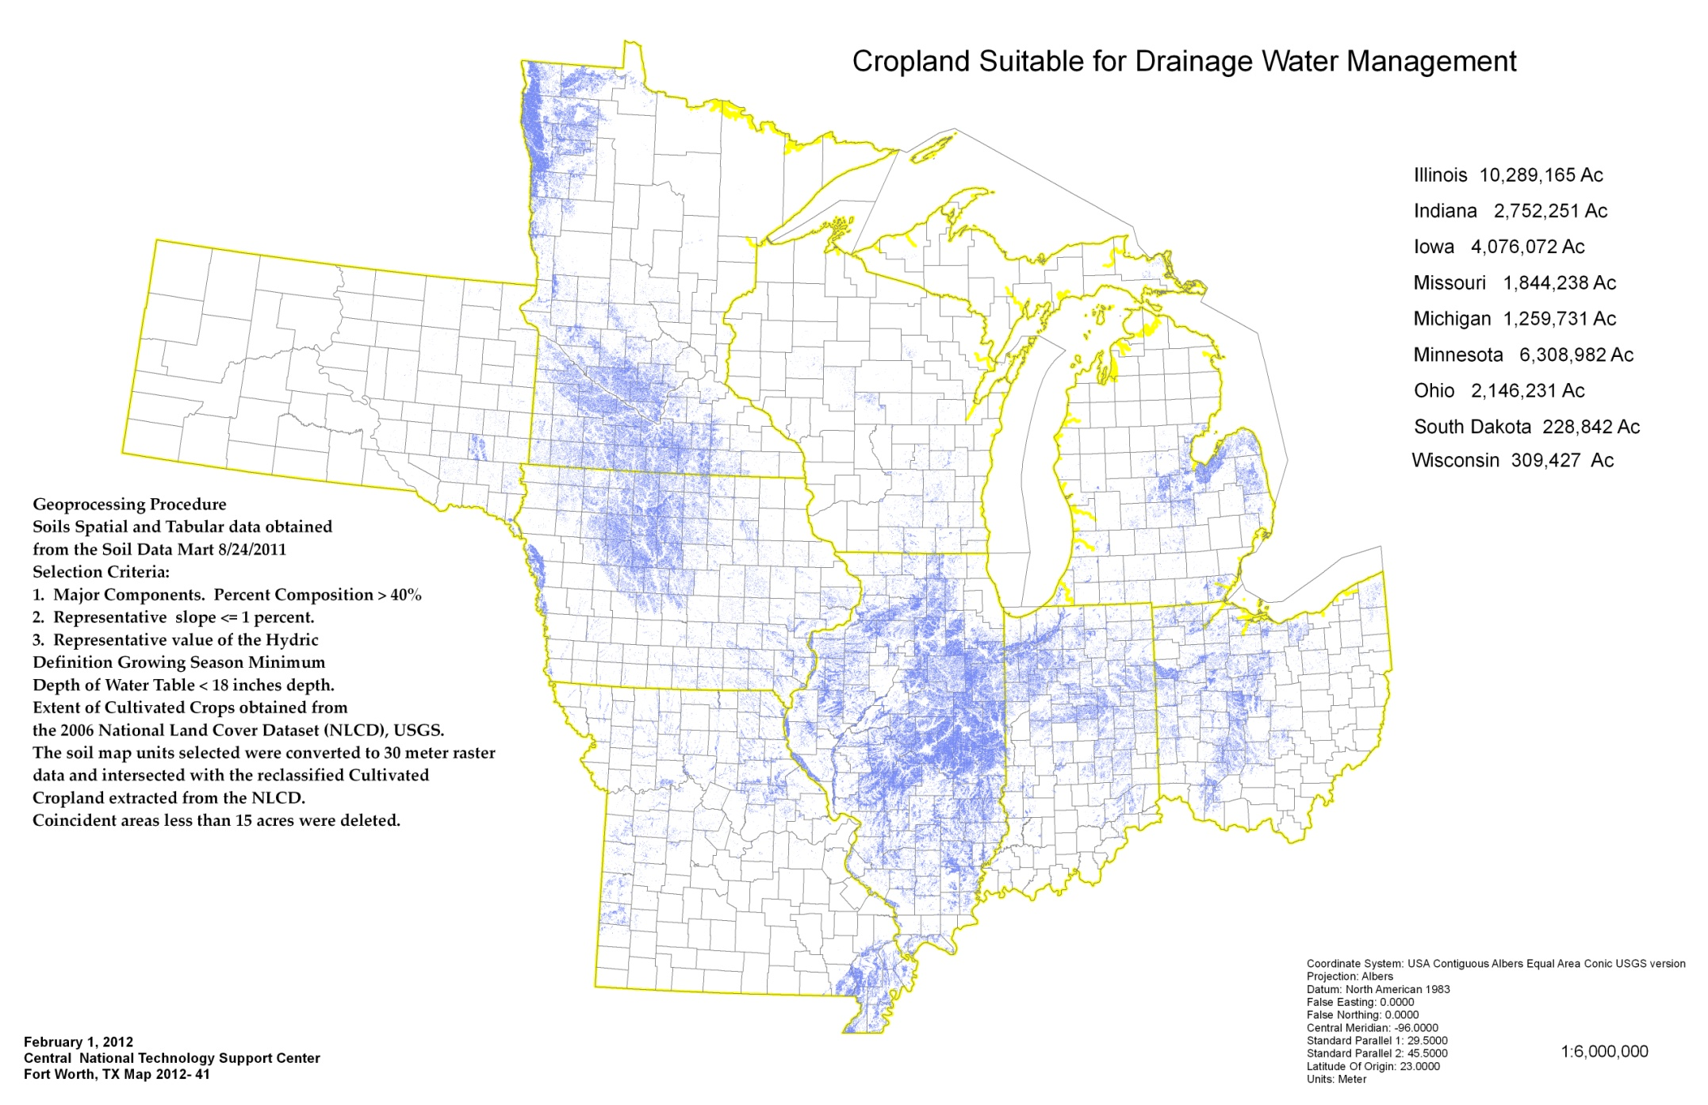
NRCS Midwest DWM Potential
Rainfall Patterns
Ownership
Technology

Slide 19
Provide an increase in hydraulic head in tile lines
Goal of 10-12 inch head difference
Only requires one water level control structure

Slide 20
Watergate Performance Curve
6” tile on 0.1% slope
8” tile on 0.1% slope

Slide 21
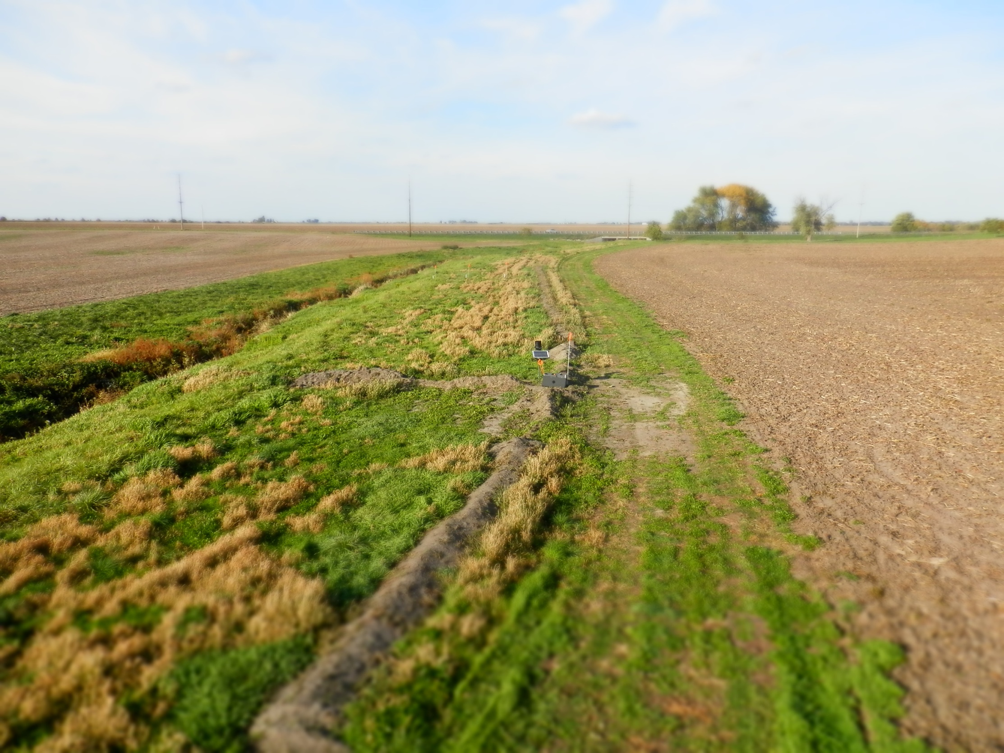
Saturated Buffers

Slide 22
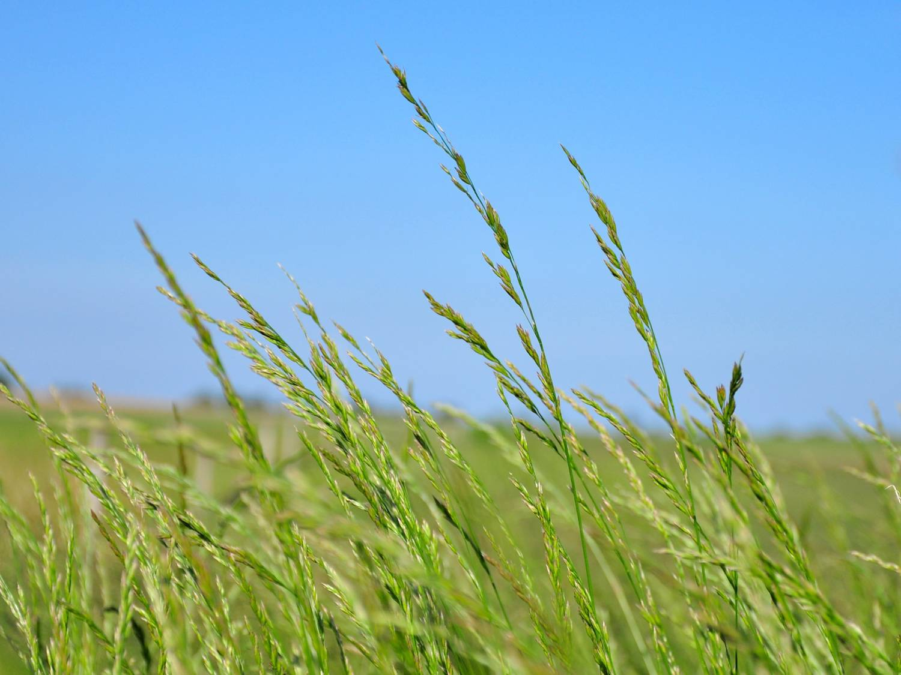
Protocol and Interactive Routine for the Design of Subsurface Bioreactors in the Midwest

Slide 23
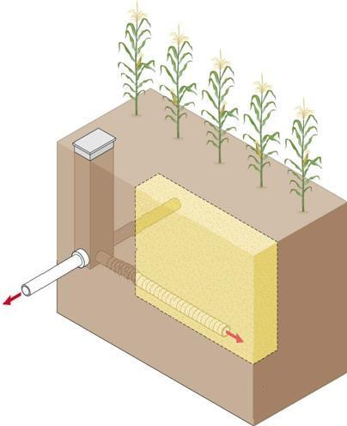
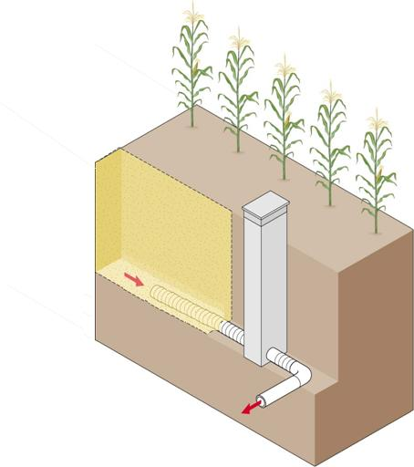
Diversion
Structure
Third Generation Bioreactors
Length/width dependent on
contributing area
5’ Soil
Backfill
Capacity
Control
Structure
Section
of perforated
tile
Trench bottom at the
tile invert level
Woodchips
Notes:
.

Slide 24
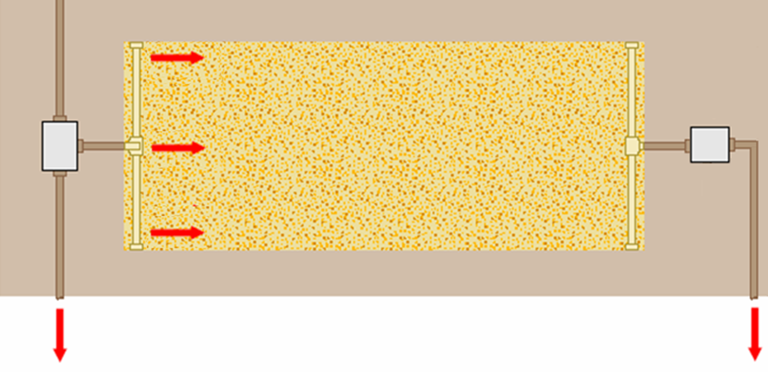
5’ Soil backfill
Top View
5’ section of non-perforated tile
Diversion
structure
Capacity control
structure
Notes:
Schematic of a wide bioreactor.

Slide 25
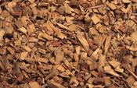
Plastic Liner
Solid pipe
Perforated pipe
Perforated pipe
Solid pipe
Notes:
25
We are currently installing third generation bioreactors. In these systems, the diversion and capacity control structures have been combined into one, resulting in lower installation costs and easier installation. We are currently exploring ways to use the bioreactors for phosphorus removal as well.

Slide 26
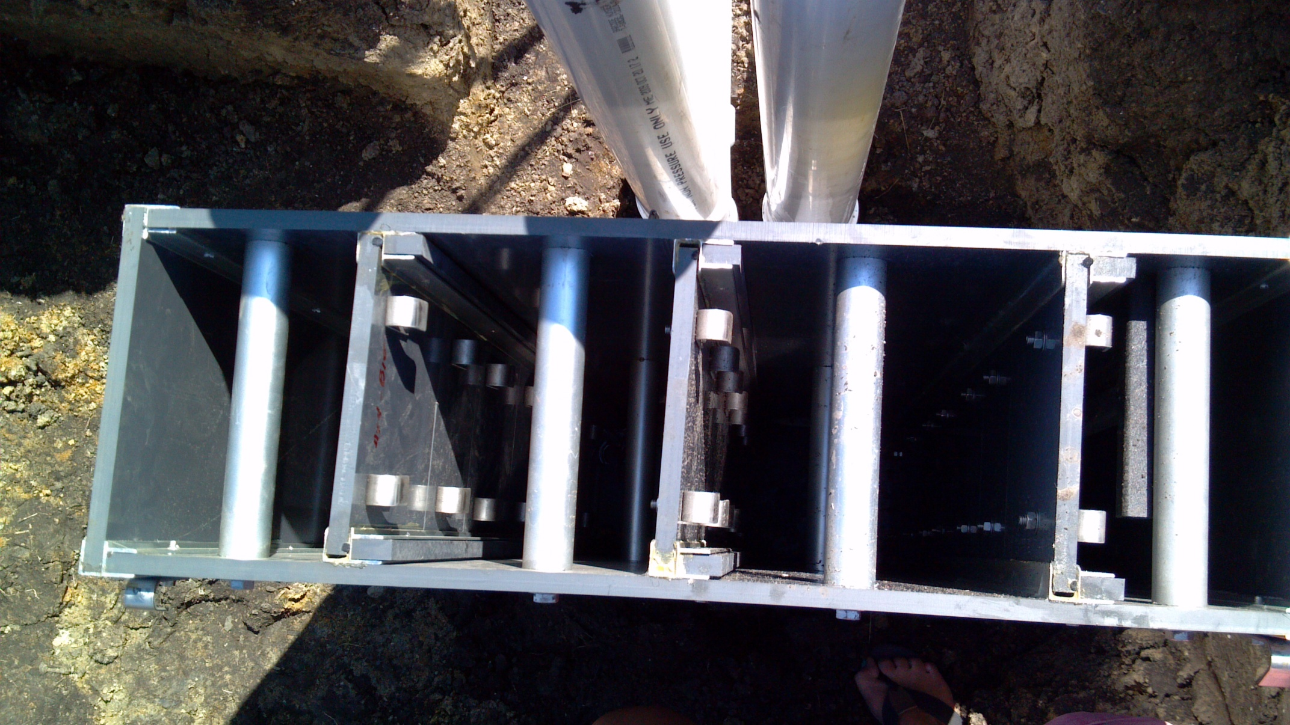

Slide 27
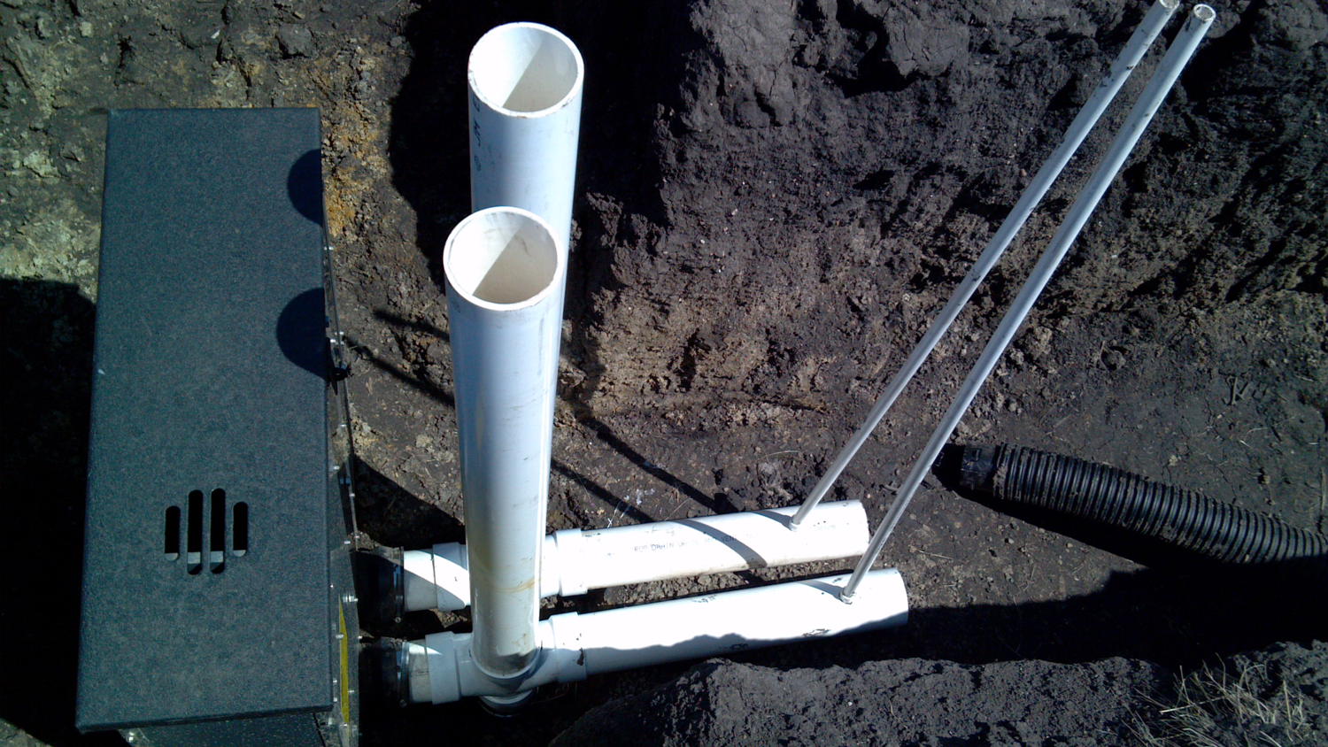

Slide 28
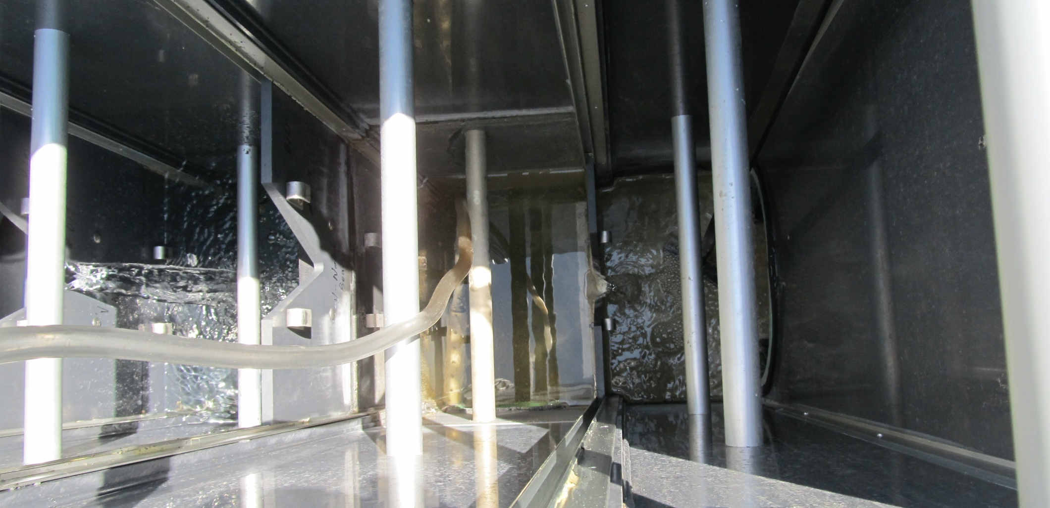

Slide 29
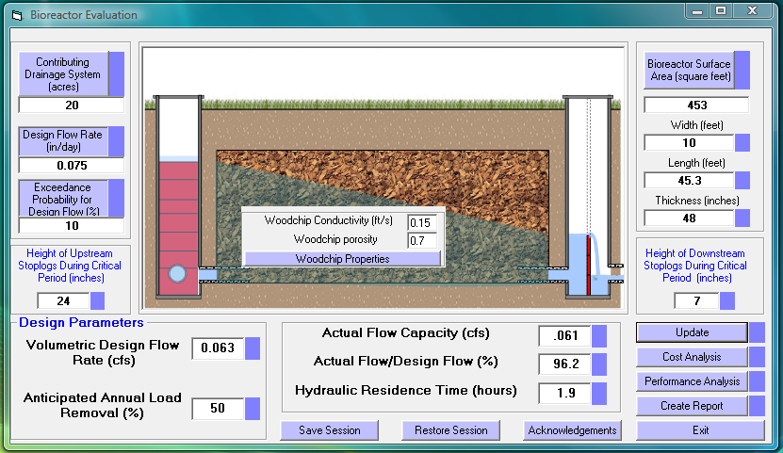
Main Interface

Slide 30
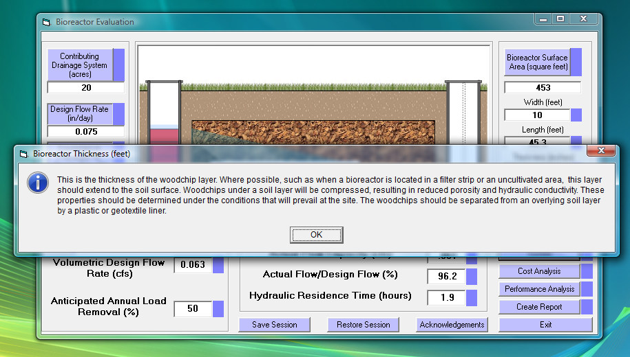
Popup Help Screens

Slide 31
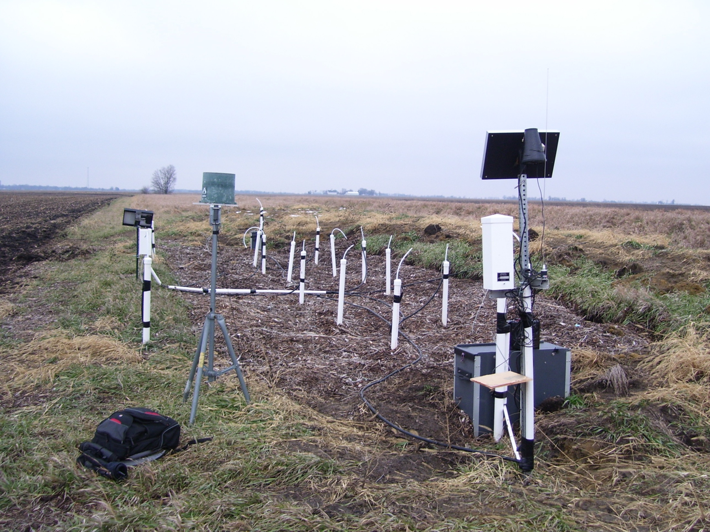
Contributing Area
Based on size and slope of outlet pipe

Slide 32
Contributing Area
Based on tile lengths and intersection angles

Slide 33
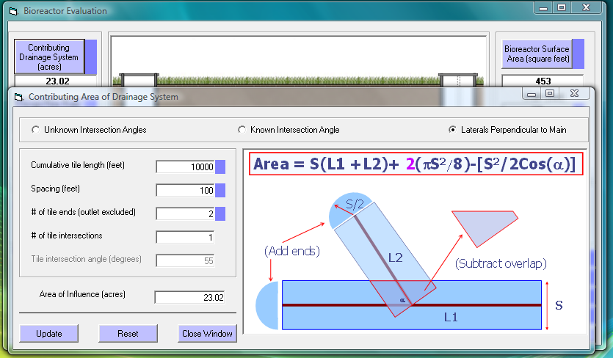
Contributing Area

Slide 34
Woodchip Properties

Slide 35
Sizing Criteria
Flow rate
Residence time
Performance

Slide 36
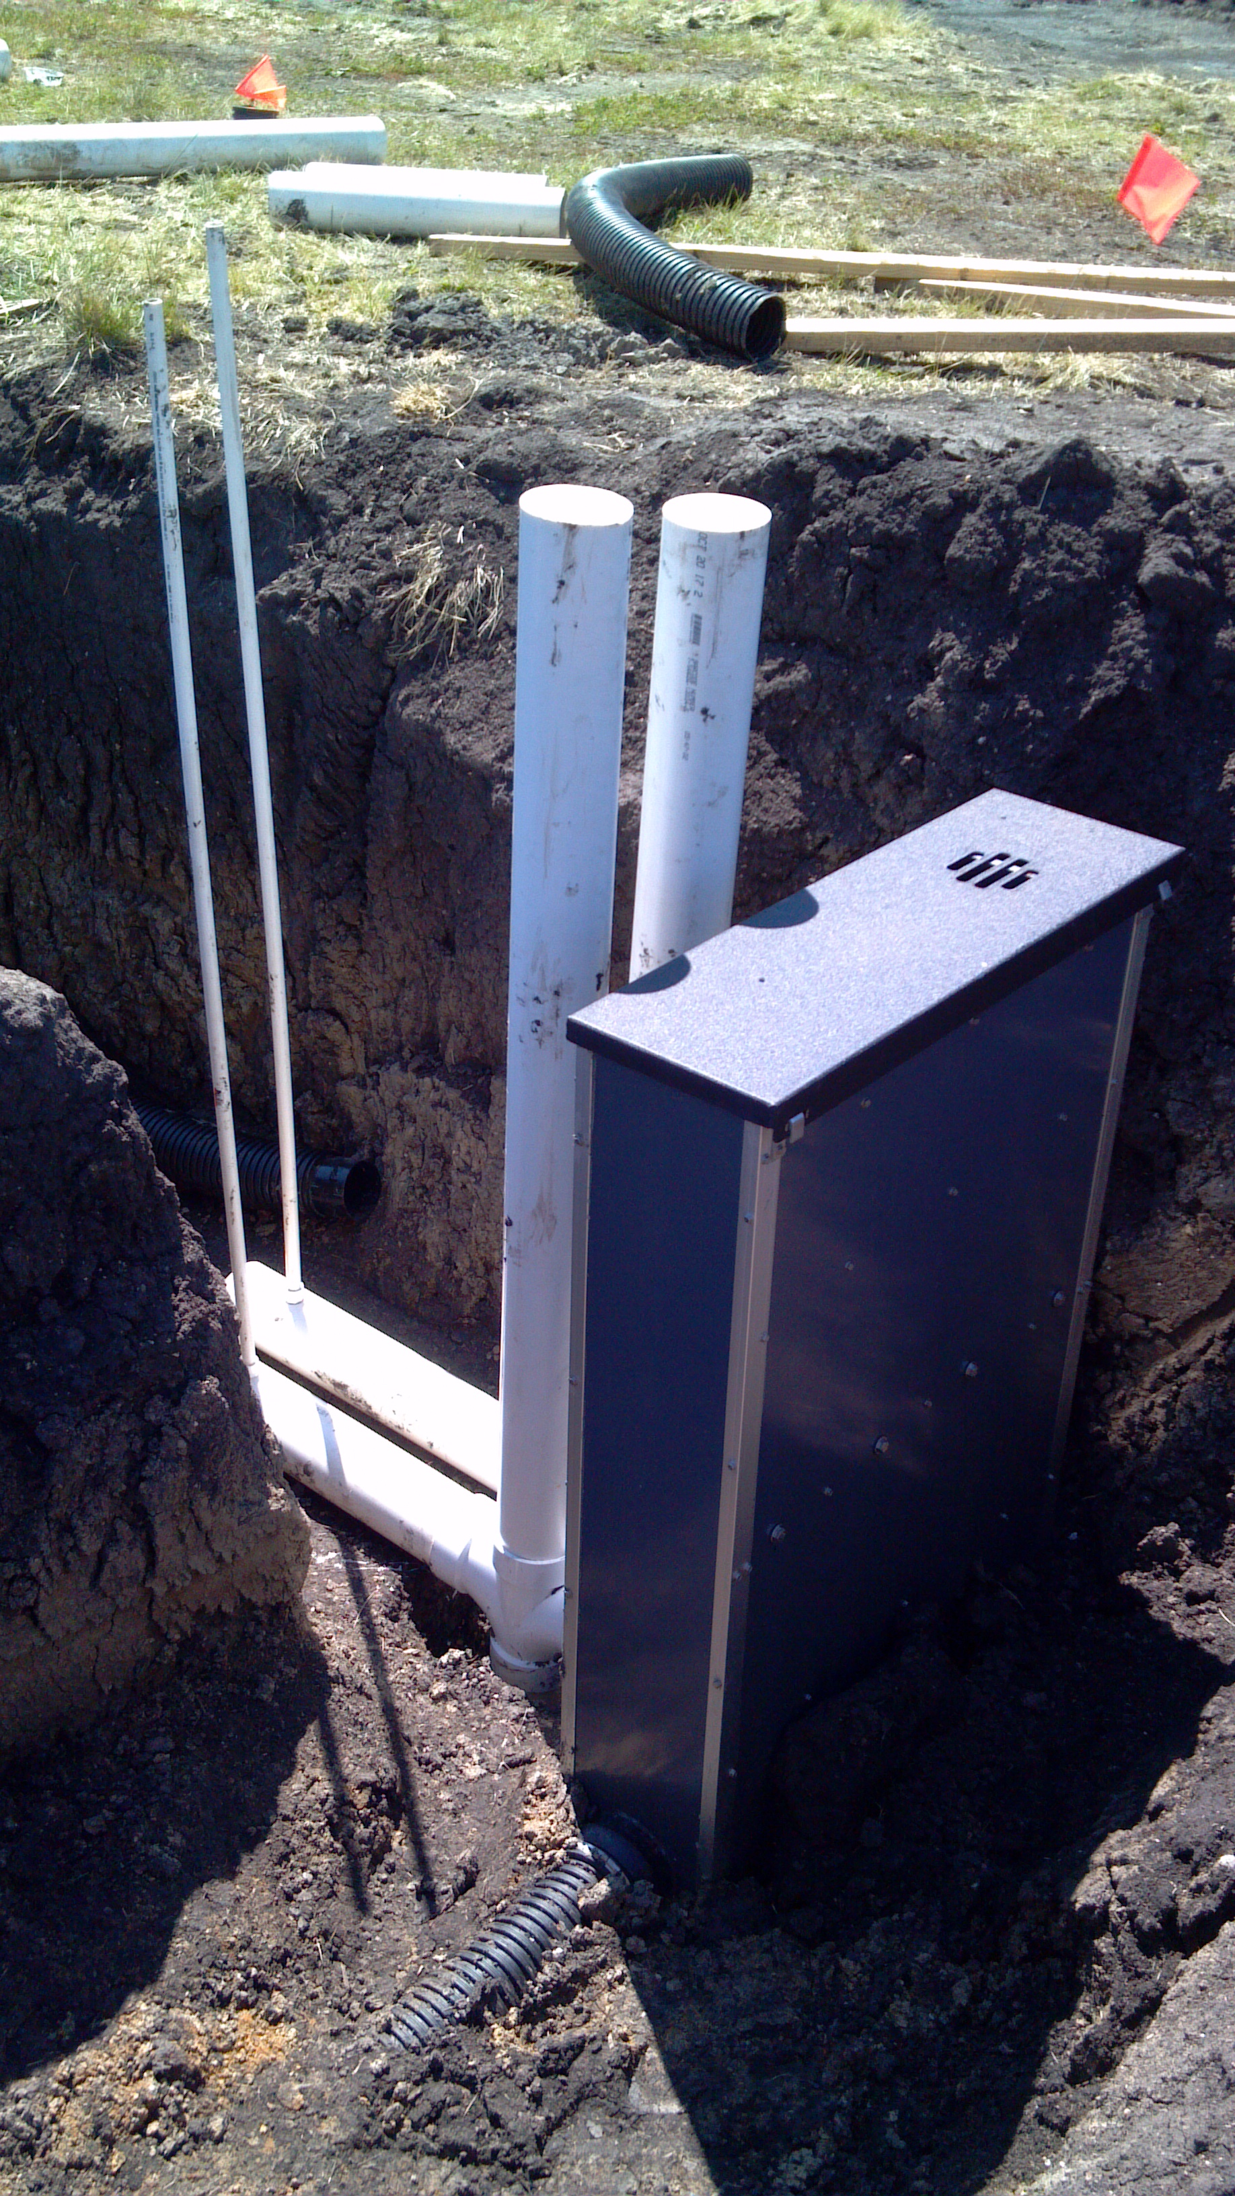
Design Flow Rate
10-year, 24 hour drain outflow event
Grassed waterways
(NRCS-412)
Constructed wetlands
(NRCS-656)

Slide 37
Design Flow Rate
DRAINMOD Simulations
Weather
Soils
Drainage System Layout

Slide 38
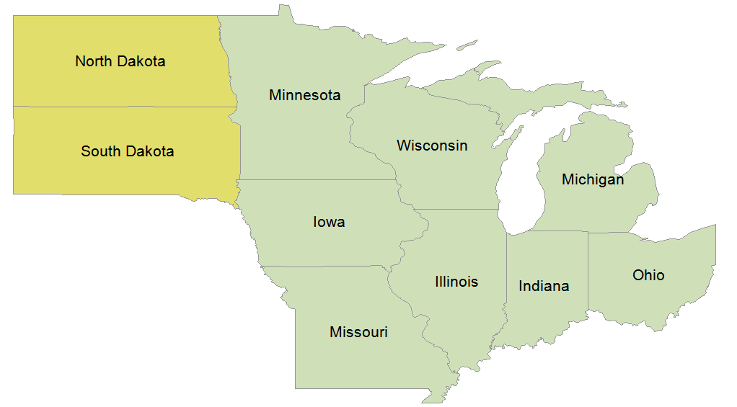
Midwest Database

Slide 39
NRCS Midwest DWM States

Slide 40
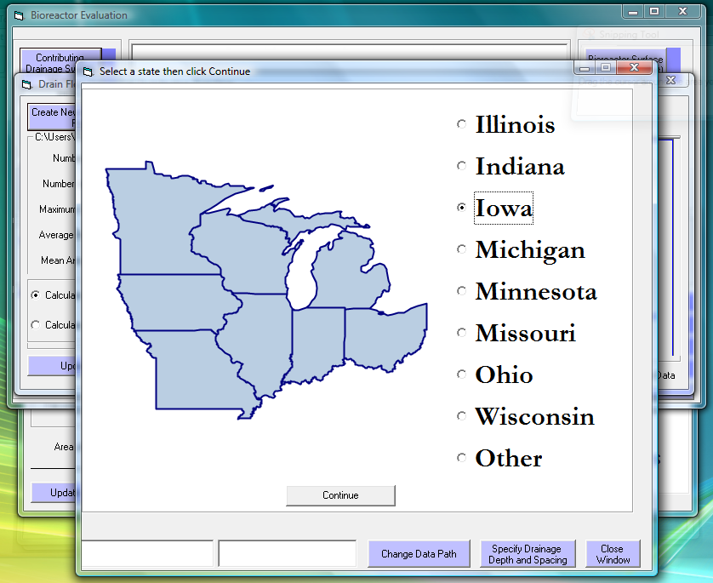

Slide 41
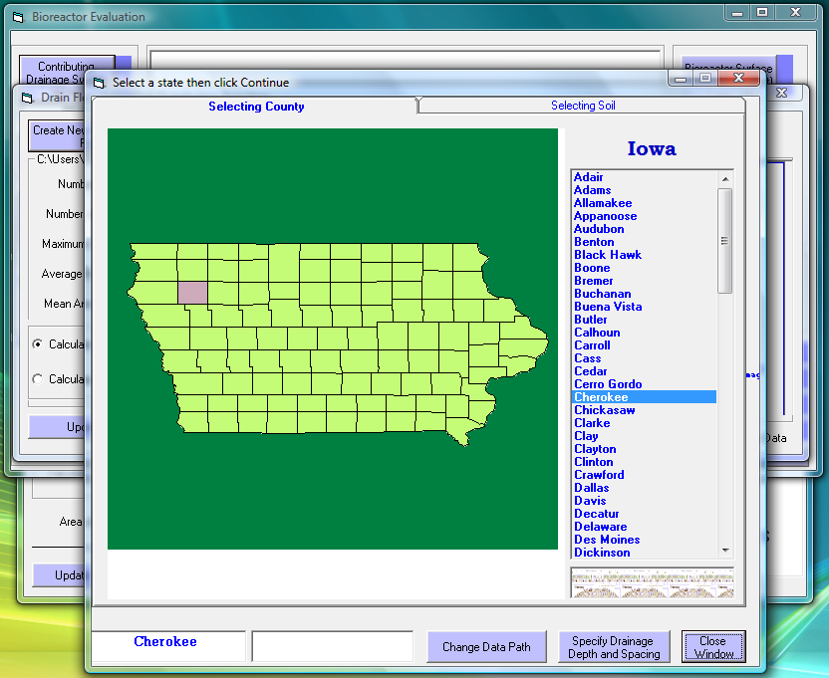

Slide 42
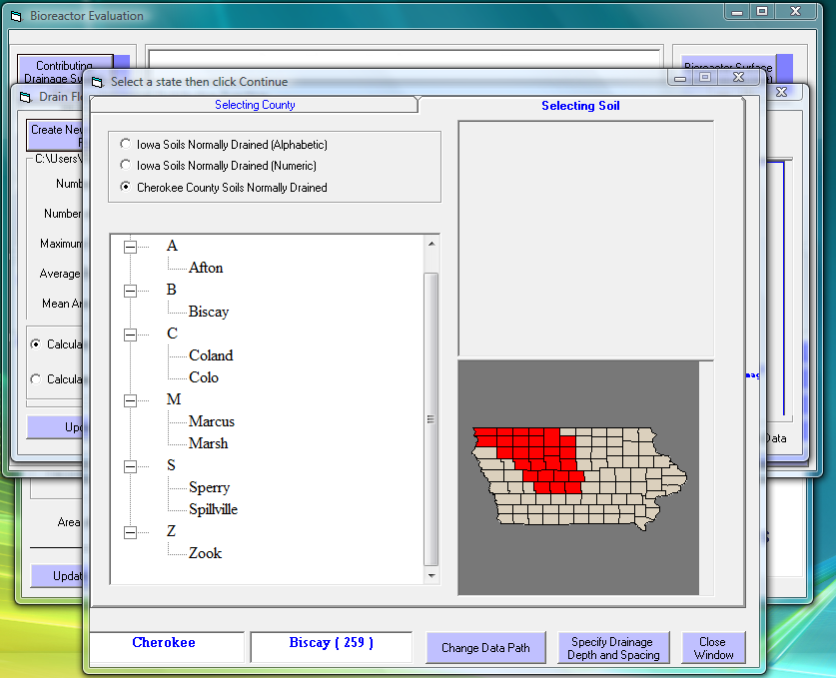

Slide 43
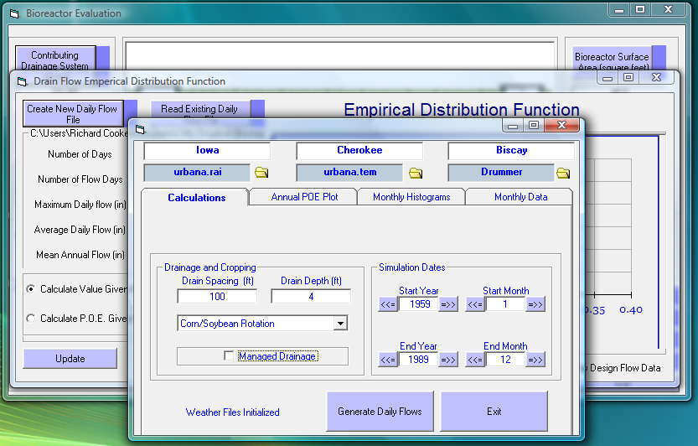

Slide 44
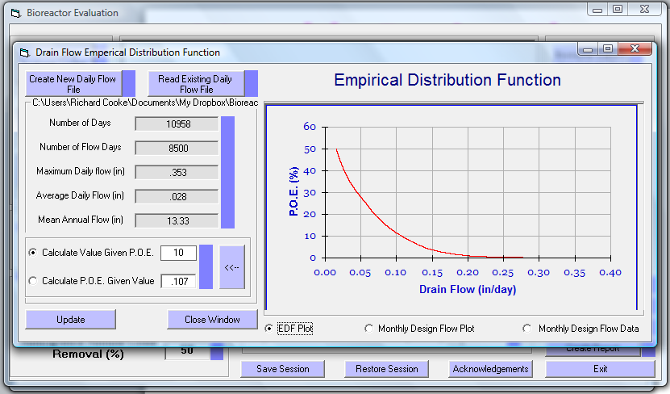
EDF for Daily Flow

Slide 45
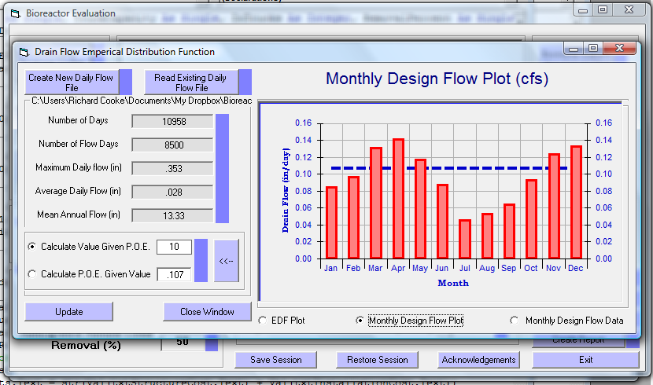
Monthly Design Flows

Slide 46
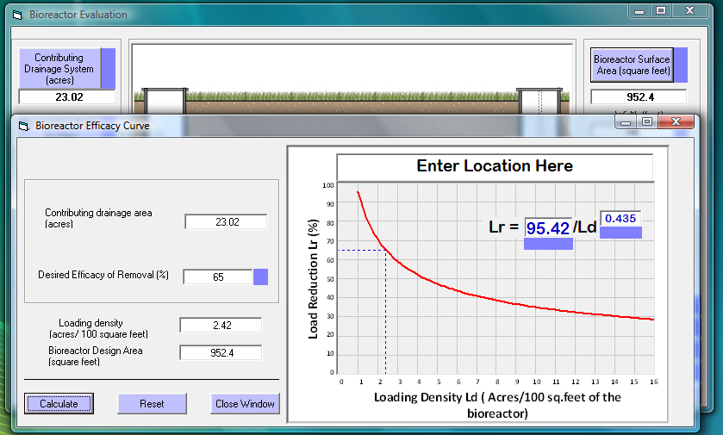
Performance Curve

Slide 47
Site | Drainage Area (acres) | Bioreactor Area (square feet) | Loading Density (acres/100 sq. feet)
Decatur West | 5 | 400 | 1.25
De Land West | 28 | 930 | 3.00
Amenia | 15 | 400 | 3.75
Decatur East | 16 | 400 | 4.00
Bloomington North | 20 | 400 | 5.00
De Land North | 39 | 560 | 7.00
De Land East | 34 | 400 | 8.50
Mount Zion | 70 | 400 | 17.5

Slide 48
Illinois Performance Curve

Slide 49
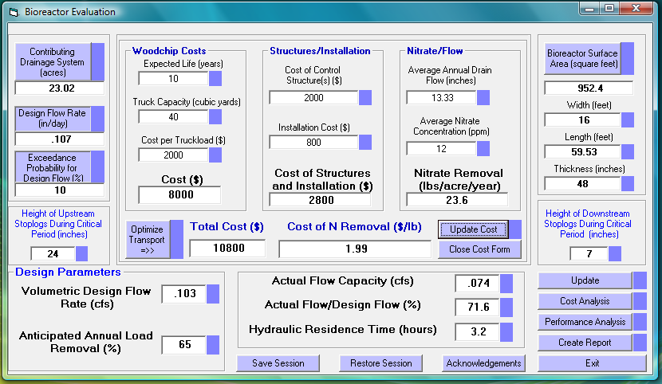
Cost Analysis

Slide 50
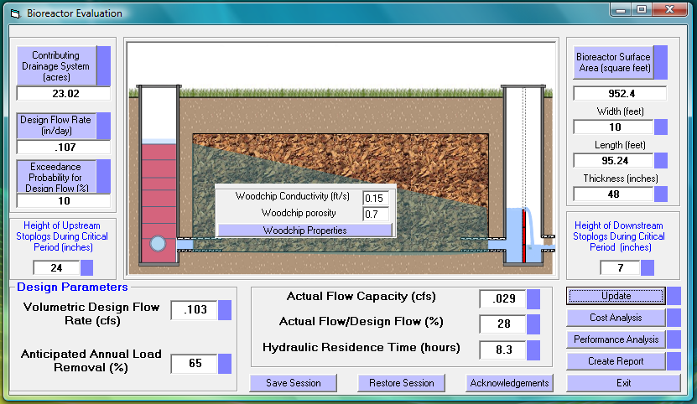
Length/Width Effects

Slide 51
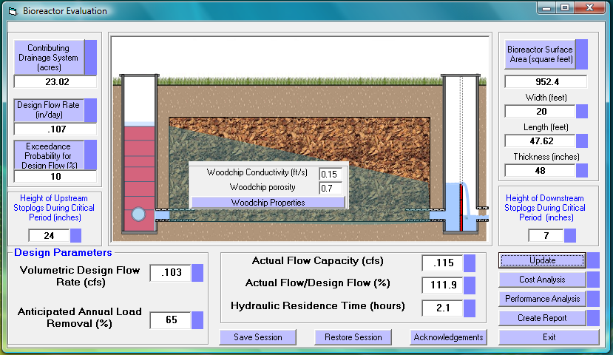
Length/Width Effects

Slide 52
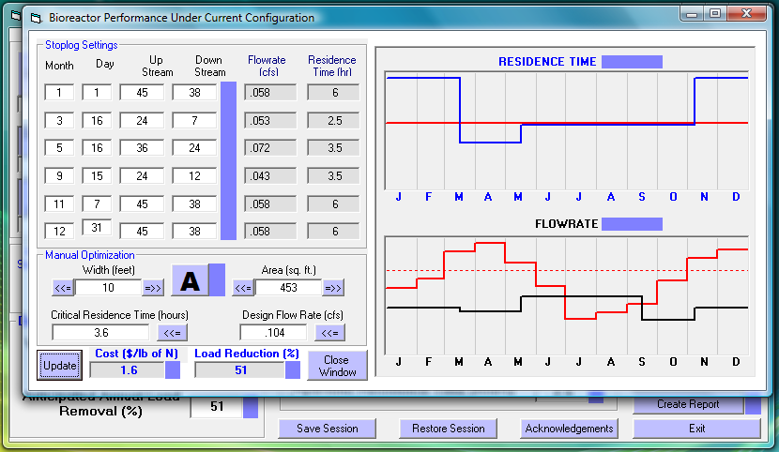
Manual Optimization

Slide 53
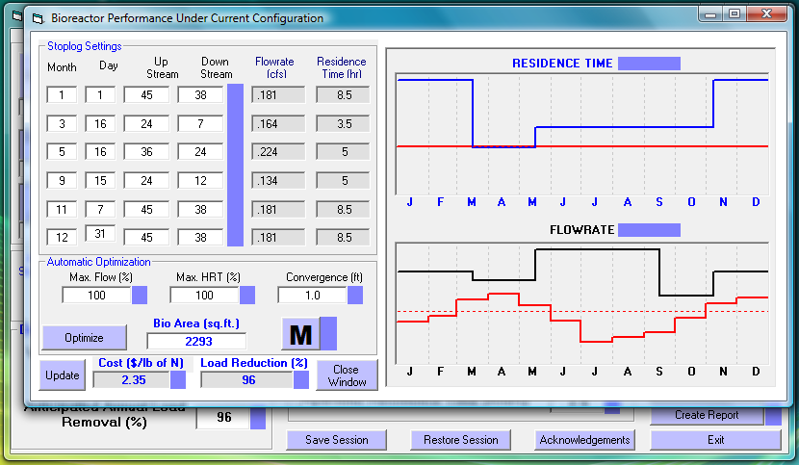
Automatic Optimization

Slide 54
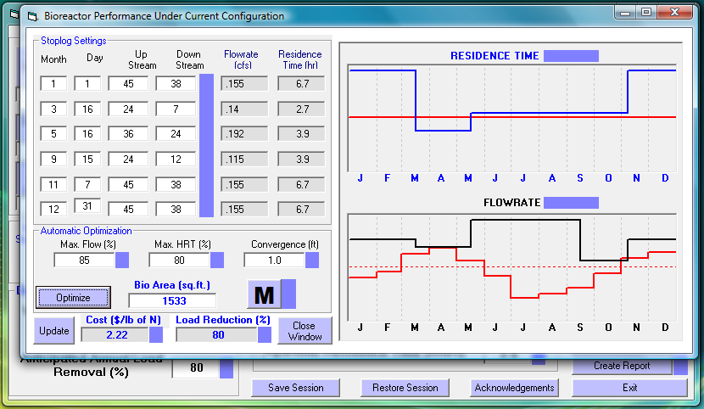
Incorporating Performance

Slide 55
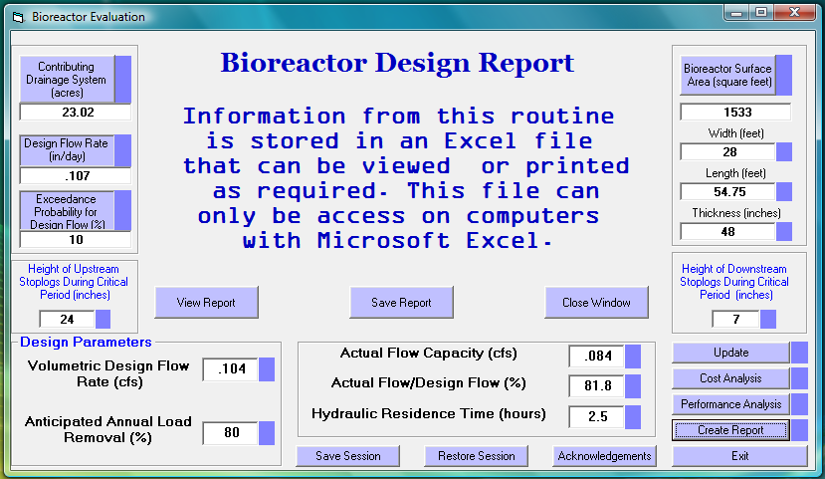
Report Generation

Slide 56
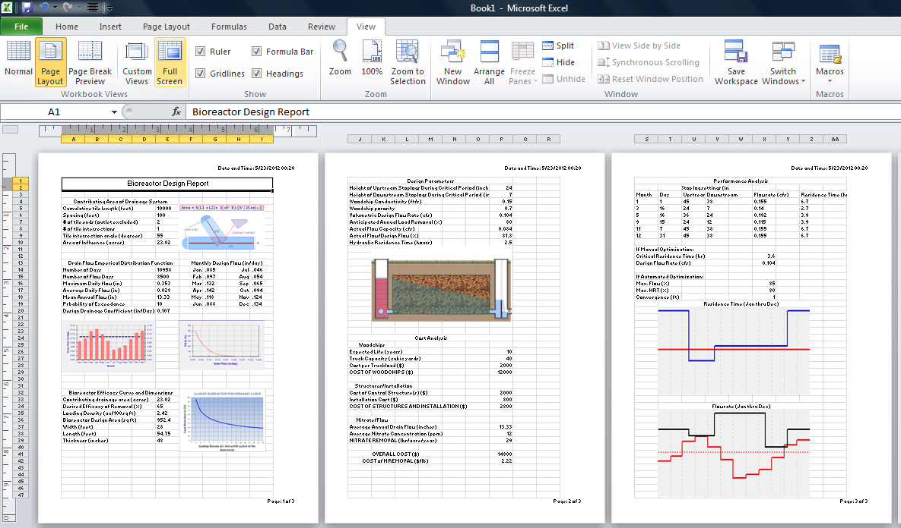
Report Generation

Slide 57
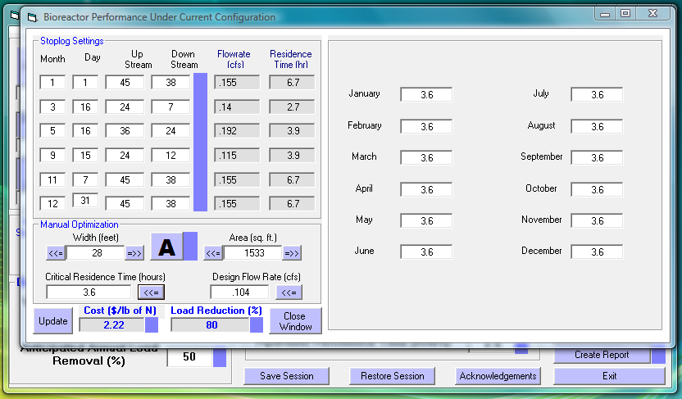
Future Work: Residence Time

Slide 58
Future Work: Nitrate Loads

Slide 59
Future Work: Long-term Trends

